Slide 1
Oxfordshire Strategic Intelligence Assessment 2022 including
Serious Violence
Safer Oxfordshire Partnership
June 2022

Slide 2
This report…
Introduction
Summary
Part 1: SIA
  Crime trends
  Abuse and exploitation
  Hate crime
  Knife crime
  Fraud and cyber crime
  Rural crime
  Road casualties
  Poverty, mental health, alcohol, drugs
  Offending and reoffending
Part 2: Serious Violence
Risk assessment - PESTELO
Finding out more
The Safer Oxfordshire Partnership works together to reduce crime and create safer communities in Oxfordshire. Each year the Partnership receives a summary of the latest data on crime and community safety in a Strategic Intelligence Assessment (SIA) for Oxfordshire.
The 2022 update is in two parts:
  Part 1 is an update of the Oxfordshire Strategic Intelligence Assessment showing overall changes in all types of crime and community safety statistics;
  Part 2 is an overview of the key data relating to serious violence.
This report is accompanied by an Oxfordshire Interactive crime dashboard showing trend charts and maps, which has been updated with data to year ending Dec21 from Home Office crime open data tables and police.uk
SIA 2022 lead authors:
  Alick Bird, Insight Analyst, Oxfordshire County Council
  Daisy Hickman, Insight Analyst and Intelligence Manager Trading Standards, Oxfordshire County Council
  Margaret Melling, Senior Research Officer, Oxfordshire County Council
last updated 15th June 2022
First step towards a Serious Violence Strategic Needs Assessment for Oxfordshire
Includes extracts from the wider Thames Valley VRU Strategic Needs Assessment

Slide 3
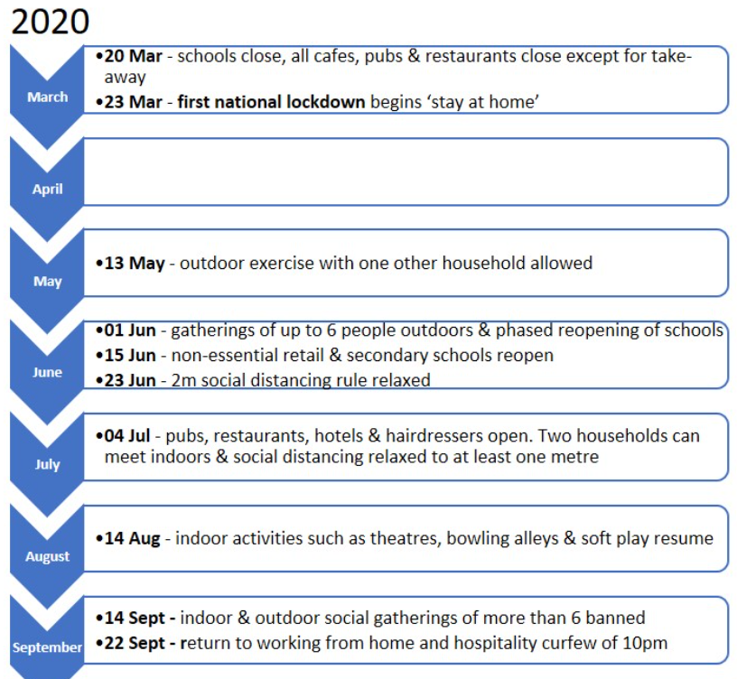
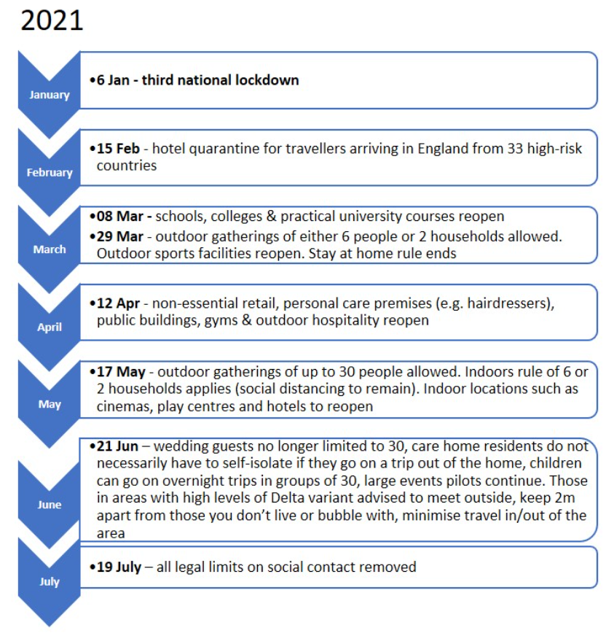
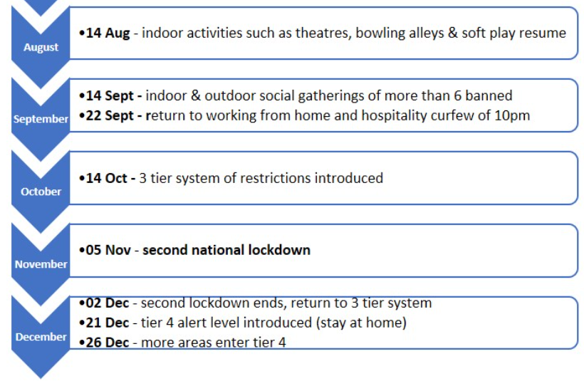
National lockdown restrictions 2020 and 2021
Introduction
Summary
Part 1: SIA
  Crime trends
  Abuse and exploitation
  Hate crime
  Knife crime
  Fraud and cyber crime
  Rural crime
  Road casualties
  Poverty, mental health, alcohol, drugs
  Offending and reoffending
Part 2: Serious Violence
Risk assessment - PESTELO
Finding out more
Wider Impacts of COVID-19 (phe.gov.uk)

Slide 4
Summary

Slide 5

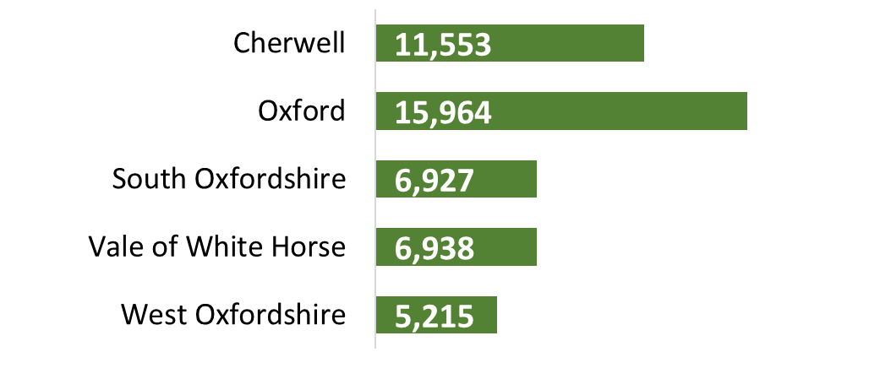



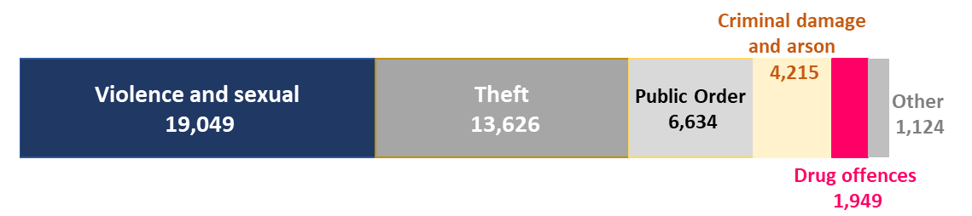


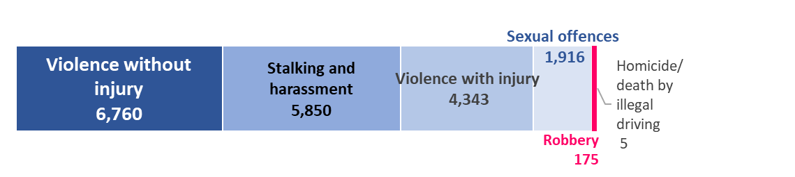
Introduction
Summary
Part 1: SIA
  Crime trends
  Abuse and exploitation
  Hate crime
  Knife crime
  Fraud and cyber crime
  Rural crime
  Road casualties
  Poverty, mental health, alcohol, drugs
  Offending and reoffending
Part 2: Serious Violence
Risk assessment - PESTELO
Finding out more
Oxfordshire: recorded crime¹
Jan-Dec21
46,597
Selected offences²
2,120
Alcohol- related crime
1,202
Cyber-related offences
548
Rural crimes
Recorded crime by type Jan-Dec21¹
Road safety³
1,014
Road casualties
230
Killed or seriously injured
[1] ONS Police recorded crime to year ending Dec 21 [2] Thames Valley Police Niche Jan-Dec 2021 [3] Oxfordshire County Council 2021
Icons designed by Freepik from Flaticon

Slide 6
Summary – crime trends
Introduction
Summary
Part 1: SIA
  Crime trends
  Abuse and exploitation
  Hate crime
  Knife crime
  Fraud and cyber crime
  Rural crime
  Road casualties
  Poverty, mental health, alcohol, drugs
  Offending and reoffending
Part 2: Serious Violence
Risk assessment - PESTELO
Finding out more
Within the category of Violence: Malicious communications, Assault without injury and Stalking offences have each seen significant increases in Oxfordshire.
Cherwell had a high overall rank in its comparator group of similar areas and higher comparative rates for most types of crime.
There has been a significant increase in fraud offences nationally and scams remain above pre-pandemic levels. Cyber-related offences have increased in Oxfordshire.
Poverty and crime
In Oxfordshire in 2021, total recorded crime was over 2.5 times more prevalent in the most income-deprived 20% of areas compared with the least income-deprived 10%.
Violence and sexual offences were 3.6 times more prevalent in the most income-deprived 20% of areas compared with the least income-deprived 10%. The gap is similar to 2019, before the COVID-19 pandemic.
National police and crime survey trends
As of Oct-Dec21, national police recorded crime (excluding fraud) had returned to the levels seen before the pandemic.
National crime survey data, however shows a significant increase in total crime drive by an increase in fraud and computer misuse offences.
Oxfordshire trends
Comparing Jan-Dec19 to Jan-Dec21 shows an increase in police recorded crime in Oxfordshire of +5% (+2,411), compared with a decrease nationally (-3%). Vale of White Horse has seen an increase in each year since 2018.
The latest crime severity score (2020/21) shows an increase in Vale of White Horse and a decrease in other districts and nationally.
There have been significant increases in Oxfordshire in recorded crimes of Public order, Violence, Sexual and Drug offences

Slide 7

Summary – abuse and exploitation
Introduction
Summary
Part 1: SIA
  Crime trends
  Abuse and exploitation
  Hate crime
  Knife crime
  Fraud and cyber crime
  Rural crime
  Road casualties
  Poverty, mental health, alcohol, drugs
  Offending and reoffending
Part 2: Serious Violence
Risk assessment - PESTELO
Finding out more
Oxfordshire: victims of crime year ending Dec21
Comparing year ending Dec21 with the average of the previous 3 years (2018 to 2020), shows increases in police recorded victims in Oxfordshire for most types of abuse and exploitation.
There were increases in the number of victims of:
  Domestic abuse (+7%)
  Older victims of violence or sexual offences (+32%)
  Rape (+19%)
  Modern slavery (+35%)
  Child Sexual Exploitation (+4%)
  Hate crime (+44%)
And decreases in the number of victims of:
  Honour-based violence
  Female Genital Mutilation
  Doorstep crime / rogue traders
  Knife crime
7,950
Victims of domestic abuse
3,345
Child victims of crime
1,262
Victims of hate crime
601
Older victims of violence or sexual offences
The number of recorded child victims of crime has continued to fall and there has been a significant fall in the number of young people arrested for drug offences.
There has been a slight increase in alcohol-related crime.
Adult reoffending rates have continued to decline and are similar to average. Juvenile reoffending rates in Oxfordshire are well below the national average

Slide 8
Part 1: Oxfordshire Strategic Intelligence Assessment

Slide 9
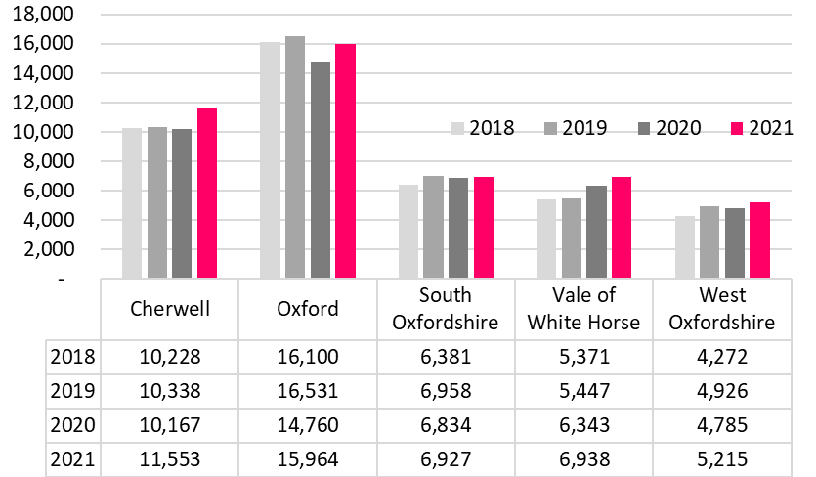
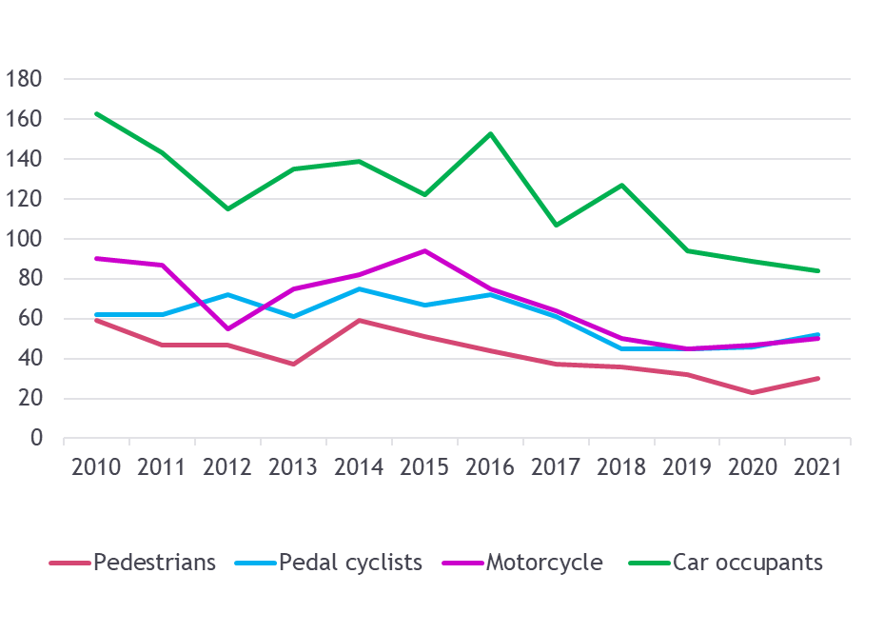
Trends in crime and community safety

Slide 10
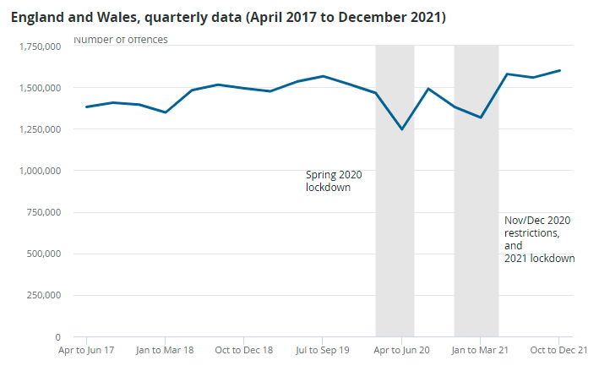
National police recorded crime has returned to pre-pandemic levels
Introduction
Summary
Part 1: SIA
  Crime trends
  Abuse and exploitation
  Hate crime
  Knife crime
  Fraud and cyber crime
  Rural crime
  Road casualties
  Poverty, mental health, alcohol, drugs
  Offending and reoffending
Part 2: Serious Violence
Risk assessment - PESTELO
Finding out more
The COVID-19 lockdowns in Spring 2020 and winter 2020/21 each saw a drop in police recorded crime across England and Wales.
As of Oct-Dec21, national police recorded crime had returned to the levels seen before the pandemic.
Police recorded crime in England and Wales (quarterly Apr17 to Dec21)
Crime in England and Wales - Office for National Statistics (ons.gov.uk); police recorded crime data are not designated as National Statistics

Slide 11
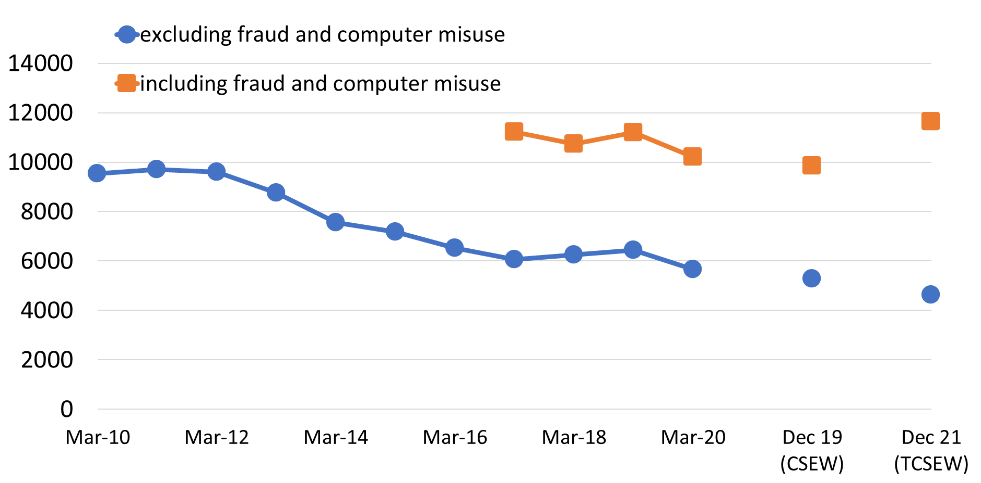
National crime survey data shows a significant increase, driven by fraud offences
Introduction
Summary
Part 1: SIA
  Crime trends
  Abuse and exploitation
  Hate crime
  Knife crime
  Fraud and cyber crime
  Rural crime
  Road casualties
  Poverty, mental health, alcohol, drugs
  Offending and reoffending
Part 2: Serious Violence
Risk assessment - PESTELO
Finding out more
The national crime survey is a better indicator of long-term trends than police recorded crime as it is unaffected by changes in levels of reporting to the police or police recording practices. The sample is not large enough however for data to be provided for Local Authorities.
In 2020, as a result of COVID-19 restrictions, the national crime survey became a telephone-operated survey and is not completely comparable with previous face-to-face estimates.
National crime survey estimates show that between Dec19* and Dec21 there was:
  An 18% increase in total crime in England and Wales, driven by a 54% increase in fraud and computer misuse offences
  A 15% decrease in theft offences
*Estimates from the TCSEW are compared with year ending Dec19 CSEW using comparable data that are not part of the main CSEW series
Crime survey estimates
(crime survey to Mar20, and telephone-operated survey Jan21 to Dec21)
Break in CSEW time series caused by change to telephone-operated survey in March 2020
Crime in England and Wales - Office for National Statistics (ons.gov.uk)
Updated

Slide 12
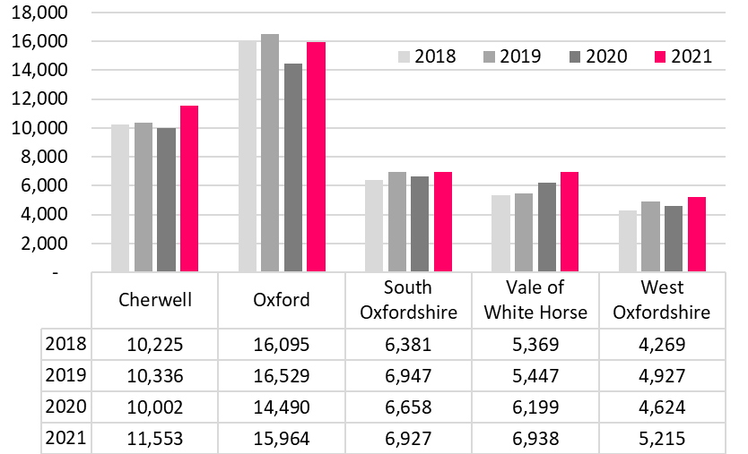
Police recorded crime in Oxfordshire in 2021 was above pre-pandemic levels with the exception of Oxford City
Introduction
Summary
Part 1: SIA
  Crime trends
  Abuse and exploitation
  Hate crime
  Knife crime
  Fraud and cyber crime
  Rural crime
  Road casualties
  Poverty, mental health, alcohol, drugs
  Offending and reoffending
Part 2: Serious Violence
Risk assessment - PESTELO
Finding out more
The Jan-Dec 2021 total police recorded crime in Oxfordshire was 46,597
The two year change, between year ending Dec19 and Dec21, was an increase of 2,411 (5%), in Oxfordshire, compared with a 3% decrease in crime across England and Wales.
By district the 2019 to 2021 change was: Cherwell +12%, Vale of White Horse +27%, West Oxfordshire +6%. Crime declined in South Oxfordshire (-0.3%) and in Oxford City (-3%).
Unlike other Oxfordshire districts, Vale of White Horse has seen an increase in each year since 2018.
Number of police recorded crime offences (excluding fraud) by local authority district
To explore this data please visit our interactive dashboard
Source ONS Police recorded crime and outcomes open data tables - GOV.UK (www.gov.uk)
Note: police recorded crime excludes offences that are not reported to, or not recorded by, the police. Trends can be influenced by changes in recording practices making it difficult to make long-term comparisons.
Updated

Slide 13
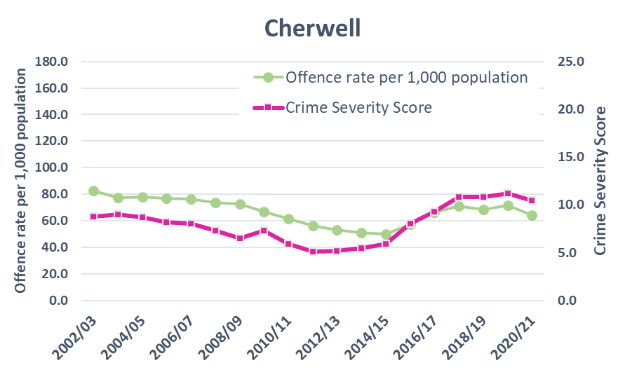
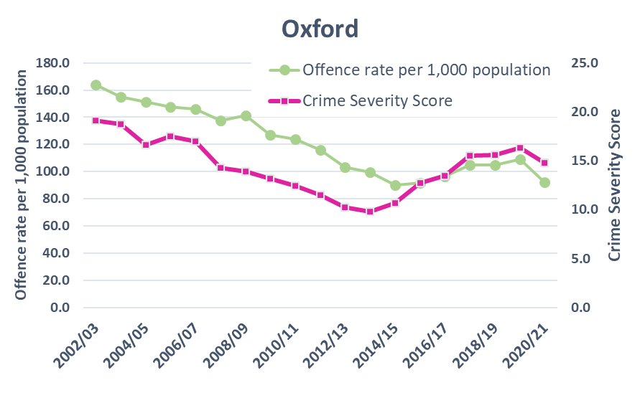
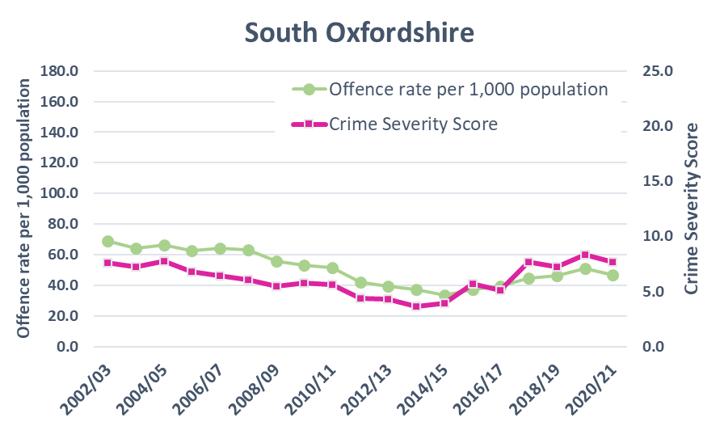
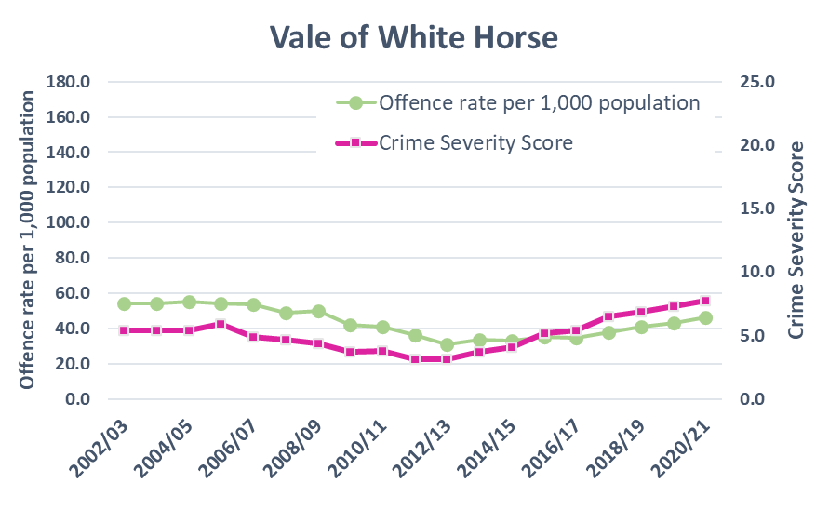
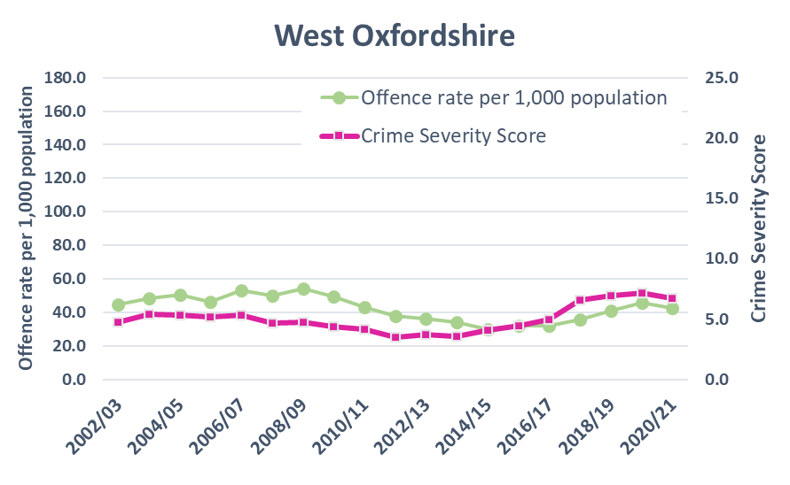
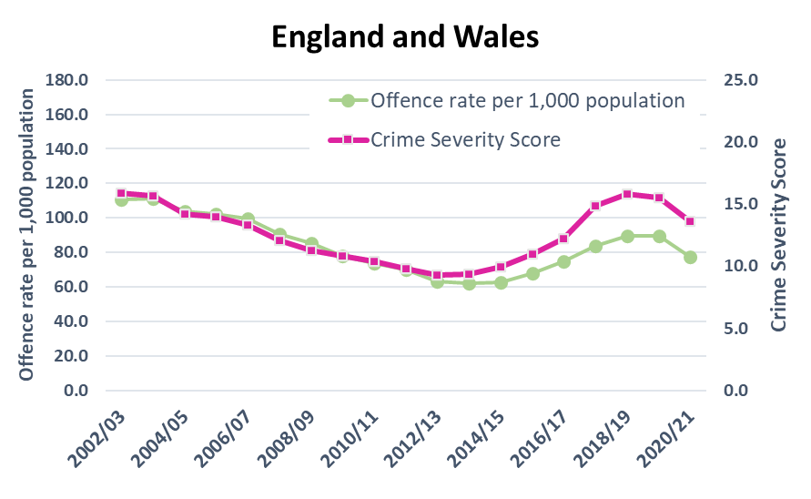
Latest crime severity score shows an increase in Vale of White Horse district
Introduction
Summary
Part 1: SIA
  Crime trends
  Abuse and exploitation
  Hate crime
  Knife crime
  Fraud and cyber crime
  Rural crime
  Road casualties
  Poverty, mental health, alcohol, drugs
  Offending and reoffending
Part 2: Serious Violence
Risk assessment - PESTELO
Finding out more
Between 2019/20 and 2020/21, the crime severity score and the offence rate each declined in Cherwell, Oxford, South Oxfordshire and West Oxfordshire
In Vale of White Horse district the crime severity score and the offence rate each increased
The Crime Severity Score upweights violence against the person, sexual offences and robbery and downweighs theft, criminal damage & arson and other crimes against society.
ONS (released October 2021); Crime Severity Score
Updated

Slide 14
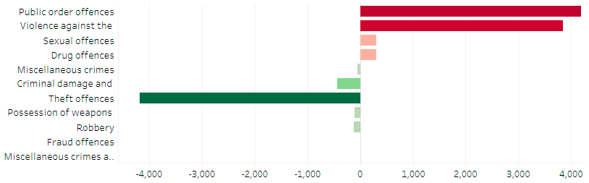
Significant increases in Public order and Violence offences
Introduction
Summary
Part 1: SIA
  Crime trends
  Abuse and exploitation
  Hate crime
  Knife crime
  Fraud and cyber crime
  Rural crime
  Road casualties
  Poverty, mental health, alcohol, drugs
  Offending and reoffending
Part 2: Serious Violence
Risk assessment - PESTELO
Finding out more
Between (an average for) 2018-20 and year ending Dec21, there were increases in police recorded crime in Oxfordshire for:
  Public order offences (+170%, +4,181)
  Violence against the person (+29%, +3,847)
  Sexual offences (+19%, +311)
  Drug offences (+19%, +308)
There was a decline in:
  Robbery (-42%, -125)
  Possession of weapons (-27%, -101)
  Theft (-23%, -4,171)
  Criminal damage/arson (-9%, -432)
Change in count of recorded crimes in Oxfordshire (Jan-Dec21 compared with 3 year av. 2018-20)
To explore this data visit our interactive dashboard
Source: Home Office Police Recorded Crime Statistics; *ONS population estimates 2020
NOTE: In 2017, “Stalking and Harassment” offences were moved out of the sub-category of “violence without injury” and into a separate sub-category
*Between 2018 to 2020 Oxfordshire’s population increased by 1.4%
Updated

Slide 15
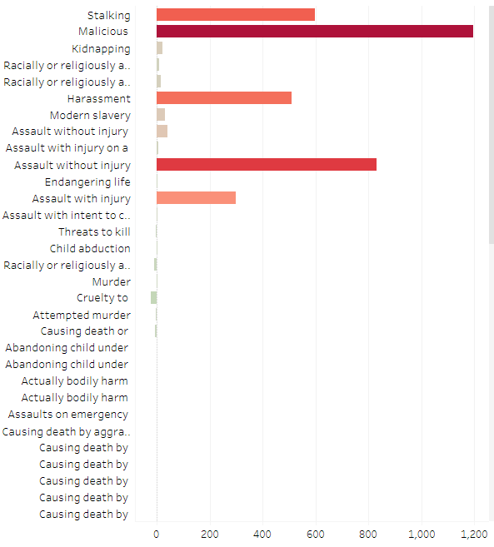
Malicious communications, Assault without injury and Stalking offences have each seen significant increases
Introduction
Summary
Part 1: SIA
  Crime trends
  Abuse and exploitation
  Hate crime
  Knife crime
  Fraud and cyber crime
  Rural crime
  Road casualties
  Poverty, mental health, alcohol, drugs
  Offending and reoffending
Part 2: Serious Violence
Risk assessment - PESTELO
Finding out more
In 2021, the overall crime category of Violence Against the Person offences in Oxfordshire, increased by 29% (3,847) compared with the benchmark years 2018-2020.
Within this overall category, the greatest increases in the count of crimes were in Malicious communications (+1,195) and Assault without injury (+830).
Stalking offences have doubled (+198% +599).
Higher volume offences within category of Violence Against the Person - change in count to Dec 2021 compared with 2018-20 average in Oxfordshire
Stalking
Malicious communications
Harassment
Assault without injury
Assault with injury
+599
To explore this data visit our interactive dashboard
+1,195
+508
+830
+299
Source: Home Office Police Recorded Crime Statistics NOTE: In 2017, “Stalking and Harassment” offences were moved out of the sub-category of “violence without injury” and into a separate sub-category
Updated

Slide 16
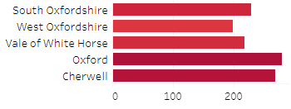
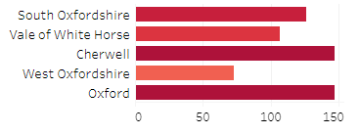
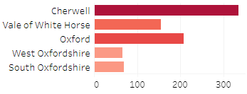
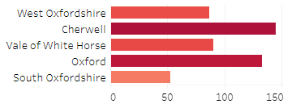
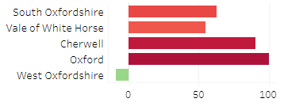
Increases in higher volume crimes within violence category have affected all districts
Introduction
Summary
Part 1: SIA
  Crime trends
  Abuse and exploitation
  Hate crime
  Knife crime
  Fraud and cyber crime
  Rural crime
  Road casualties
  Poverty, mental health, alcohol, drugs
  Offending and reoffending
Part 2: Serious Violence
Risk assessment - PESTELO
Finding out more
Malicious communications
Stalking
Assault without injury
Harassment
Assault with injury
change in count to Dec 2021 compared with 2018-20 average
To explore this data visit our interactive dashboard
Source: Home Office Police Recorded Crime Statistics

Slide 17
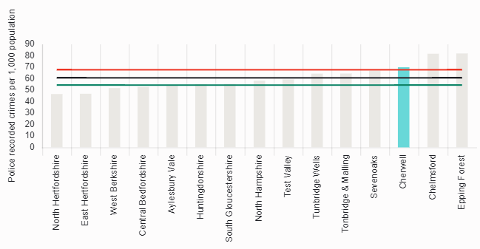
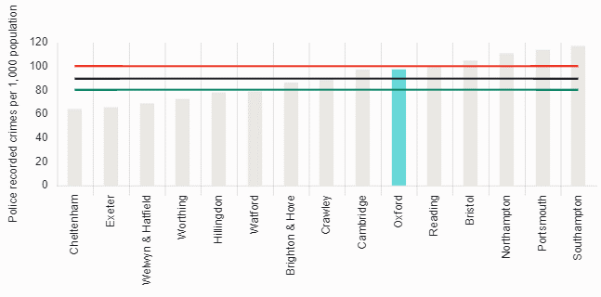
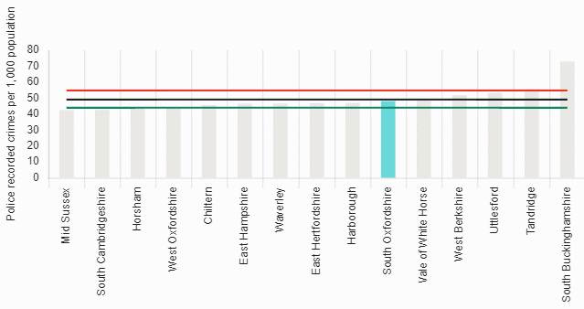
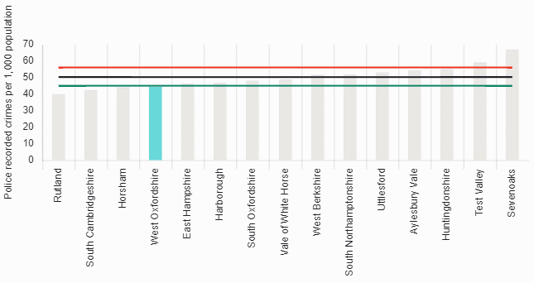

Cherwell had a high overall rank in its comparator group of similar areas
Introduction
Summary
Part 1: SIA
  Crime trends
  Abuse and exploitation
  Hate crime
  Knife crime
  Fraud and cyber crime
  Rural crime
  Road casualties
  Poverty, mental health, alcohol, drugs
  Offending and reoffending
Part 2: Serious Violence
Risk assessment - PESTELO
Finding out more
For year ending June 2021, Cherwell was ranked the highest of Oxfordshire districts in its group of 15 statistical neighbours (3rd), followed by Vale of White Horse ranked 5th.
Comparative rates of all crime per 1,000 population year ending June 2021
Oxfordshire Districts each ranked within its group of 15 statistical neighbours
Epping Forest
Cherwell
North Herts
Southampton
Oxford
Cheltenham
South Bucks
Vale of WH
South Oxon
Mid Sussex
Sevenoaks
West Oxon
Rutland
3*
5*
6*
6*
12*
Performance for Thames Valley Police | Police.uk (www.police.uk)
* Rank position within group of 15 statistical neighbours

Slide 18
Cherwell had higher comparative rates for most types of crime
Introduction
Summary
Part 1: SIA
  Crime trends
  Abuse and exploitation
  Hate crime
  Knife crime
  Fraud and cyber crime
  Rural crime
  Road casualties
  Poverty, mental health, alcohol, drugs
  Offending and reoffending
Part 2: Serious Violence
Risk assessment - PESTELO
Finding out more
For individual types of crime, Oxford generally had the highest rates in Oxfordshire. When compared to similar areas, however, Cherwell had higher rates for more types of crime (including drugs, shoplifting, and theft from the person, as well as ‘other’ crime/theft).
Rates of crime per 1,000 population, for Oxfordshire Districts with similar area comparisons¹
 | Cherwell | Oxford | South Oxfordshire | Vale of White Horse | West Oxfordshire
All crime | 69.99 | 97.58 | 48.14 | 49.03 | 44.43
Bicycle theft | 0.51 | 9.13 | 0.63 | 0.73 | 0.44
Burglary | 2.38 | 5.28 | 3.14 | 2.08 | 2.38
Criminal damage and arson | 6.7 | 7.73 | 5.55 | 5.8 | 5.6
Drugs | 3.26 | 4.87 | 2.4 | 2.67 | 1.66
Other crime | 1.94 | 1.68 | 1.07 | 1.13 | 0.86
Other theft | 6.02 | 6.51 | 4.36 | 3.34 | 3.91
Possession of weapons | 0.78 | 1.06 | 0.38 | 0.43 | 0.37
Public order | 6.84 | 10.95 | 4.8 | 6.05 | 4.67
Robbery | 0.31 | 0.6 | 0.2 | 0.17 | 0.07
Shoplifting | 5.47 | 9.43 | 2.68 | 2 | 1.79
Theft from the person | 1.03 | 1.78 | 0.53 | 0.47 | 0.54
Vehicle crime | 3.39 | 5.46 | 3.4 | 2.25 | 2.85
Violence and sexual offences | 31.35 | 33.1 | 19 | 21.92 | 19.29
Key
- higher rate than normal² when compared to similar areas
– lower rate than normal² when compared to similar areas
Police.uk What’s happening in your area? (Data as of year ending June 2021); [1] How Most Similar Groups are formed [2] “Calculating the red and green lines” (at bottom of page)
Updated

Slide 19
Abuse and exploitation

Slide 20
Increases in police recorded victims
Introduction
Summary
Part 1: SIA
  Crime trends
  Abuse and exploitation
  Hate crime
  Knife crime
  Fraud and cyber crime
  Rural crime
  Road casualties
  Poverty, mental health, alcohol, drugs
  Offending and reoffending
Part 2: Serious Violence
Risk assessment - PESTELO
Finding out more
Comparing year ending December 2021 with the average of the previous 3 years (2018 to 2020), shows an increase in the number of police recorded victims of domestic abuse, older victims of violence and sexual offences, rape, modern slavery and child sexual exploitation in Oxfordshire.
There was a decrease in the number of recorded victims of honour-based violence and female genital mutilation, however these are often hidden harms which are not reflected by crime figures.
Number of police recorded victims¹ of abuse and exploitation in Oxfordshire (Jan-Dec)
Recorded victims of.. | 2017 | 2018 | 2019 | 2020 | 2021 | Change from average of 2018-20 to 2021
Domestic abuse | 6,986 | 7,163 | 7,285 | 7,851 | 7,950 | 517 | 7%
Older victims of violence and sexual offences | 250 | 403 | 410 | 555 | 601 | 145 | 32%
Rape crimes | 428 | 473 | 508 | 503 | 588 | 93 | 19%
Modern slavery | 99 | 124 | 132 | 149 | 182 | 47 | 35%
Child sexual exploitation | 83 | 106 | 60 | 94 | 90 | 3 | 4%
Honour-based violence | 47 | 33 | 34 | 24 | 26 | -4 | -14%
Female genital mutilation | 5 | 6 | 2 | 1 | 0 | -3 | -100%
Thames Valley Police Crime Recording System - Niche RMS; [1] count is of total recorded unique victims in the 12 month period, whether or not individuals have been a victim more than once
Updated

Slide 21
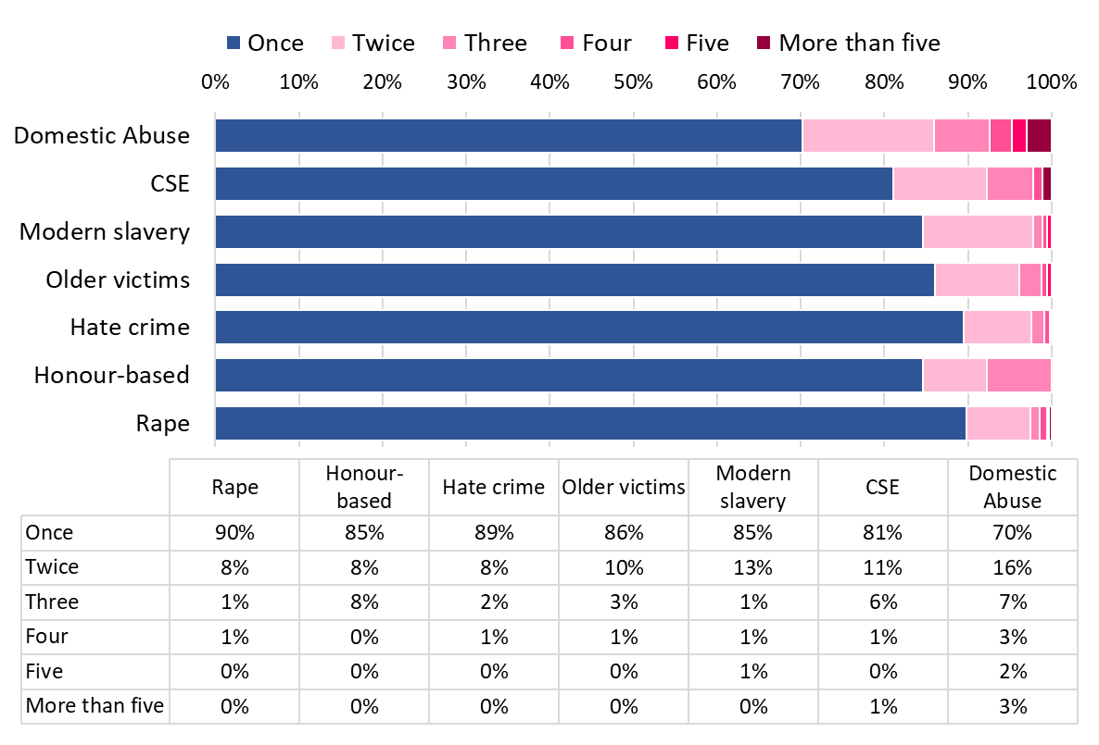
Almost a third of domestic abuse victims in 2021 were repeat victims
Introduction
Summary
Part 1: SIA
  Crime trends
  Abuse and exploitation
  Hate crime
  Knife crime
  Fraud and cyber crime
  Rural crime
  Road casualties
  Poverty, mental health, alcohol, drugs
  Offending and reoffending
Part 2: Serious Violence
Risk assessment - PESTELO
Finding out more
30% of victims of domestic abuse in Oxfordshire were recorded at least twice in 2021.
  15% were a victim of an occurrence on three or more occasions. This is an increase on 2020, where 13% were a victim on three or more occasions.
19% of victims of Child Sexual Exploitation (CSE) were a repeat victim in 2021
Proportion of victims¹ by number of times recorded as a victim Jan-Dec 2021
Thames Valley Police Crime Recording System - Niche RMS (extracted Feb 2021)
[1] Proportion of total unique victims
Updated

Slide 22
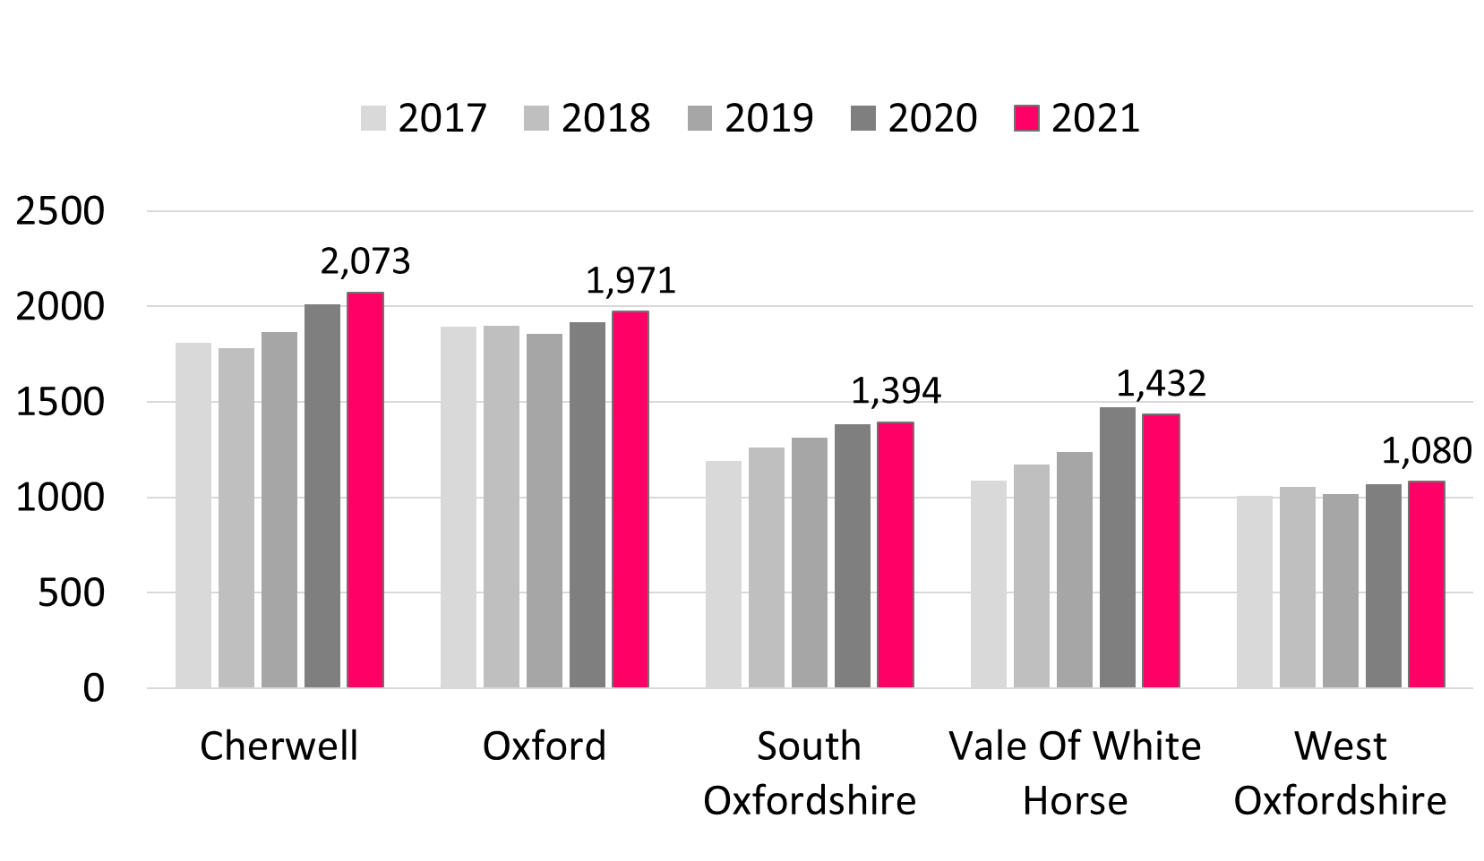
Increase in victims of domestic abuse in Oxfordshire
Introduction
Summary
Part 1: SIA
  Crime trends
  Abuse and exploitation
  Hate crime
  Knife crime
  Fraud and cyber crime
  Rural crime
  Road casualties
  Poverty, mental health, alcohol, drugs
  Offending and reoffending
Part 2: Serious Violence
Risk assessment - PESTELO
Finding out more
In 2021 (Jan-Dec) Thames Valley Police recorded a total of 7,950 victims of domestic abuse in Oxfordshire
This was 7% above the 3 year average for the years 2018 to 2020, with the greatest increases in Vale of White Horse (+11%) and Cherwell (10%)
Count of police recorded victims¹ of domestic abuse (all occurrences)
Thames Valley Police Crime Recording System - Niche RMS; [1] count is of total recorded unique victims in the 12 month period, whether or not individuals have been a victim more than once
Updated

Slide 23
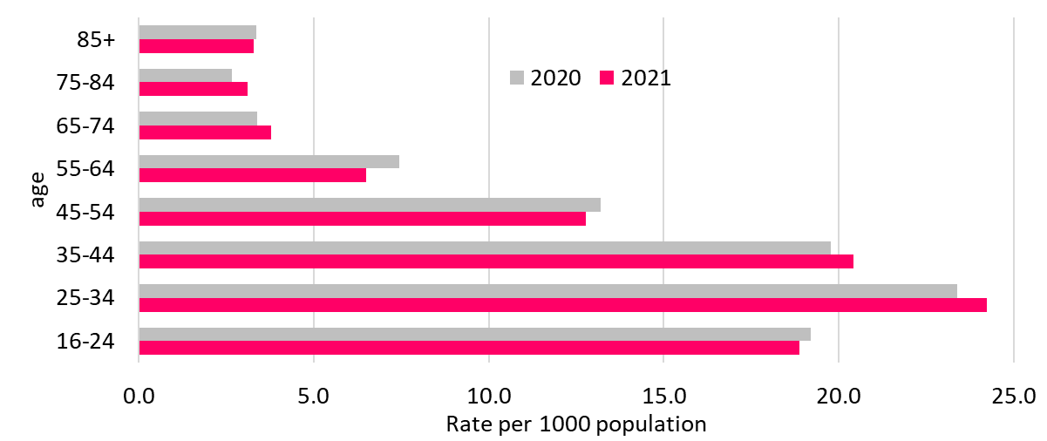
Younger working age people more likely to be victims of domestic abuse; increases in post-retirement age groups
Introduction
Summary
Part 1: SIA
  Crime trends
  Abuse and exploitation
  Hate crime
  Knife crime
  Fraud and cyber crime
  Rural crime
  Road casualties
  Poverty, mental health, alcohol, drugs
  Offending and reoffending
Part 2: Serious Violence
Risk assessment - PESTELO
Finding out more
The rate (per 1,000 population) of domestic abuse victims, for year ending December 2021, was highest in the age group 25-34 (24.2 per 1,000 population).
There has been an increase in the rate (per 1,000 population) of domestic abuse victims compared to 2020 data, in the age groups 25-44 and 65-84.
Domestic abuse victims by broad age Oxfordshire (calendar years 2020 and 2021) rate per 1000 population
Thames Valley Police Crime Recording System - Niche RMS; ONS 2020 mid year population estimates (Note that rates for 2018, 2019 and 2020 each use the 2019 pop estimate) [1] Total recorded unique victims in the 12 month period, whether or not individuals have been a victim more than once
New

Slide 24
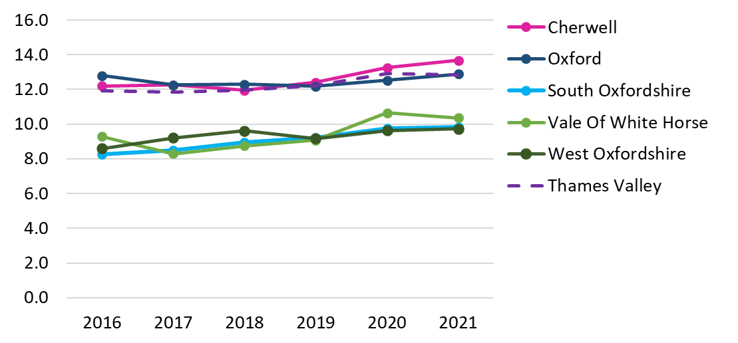
Cherwell continues to have an above-average rate of domestic abuse victims
Introduction
Summary
Part 1: SIA
  Crime trends
  Abuse and exploitation
  Hate crime
  Knife crime
  Fraud and cyber crime
  Rural crime
  Road casualties
  Poverty, mental health, alcohol, drugs
  Offending and reoffending
Part 2: Serious Violence
Risk assessment - PESTELO
Finding out more
The rate (per 1,000 population) of domestic abuse victims, for year ending December 2021, was highest in Cherwell (13.7 per 1,000 population)
Cherwell district’s rate per 1000 population in 2021 was above the Thames Valley rate (12.8), the Oxfordshire rate (11.4) and above Oxford (12.9), Vale of White Horse (10.4), West Oxfordshire (9.7), and South Oxfordshire (9.8).
Police recorded victims¹ of domestic abuse (all occurrences), rate per 1,000 population
Thames Valley Police Crime Recording System - Niche RMS; ONS 2020 mid year population estimates (Note that rates for 2019 and 2020 each use the 2019 pop estimate) [1] Total recorded unique victims in the 12 month period, whether or not individuals have been a victim more than once
Updated

Slide 25
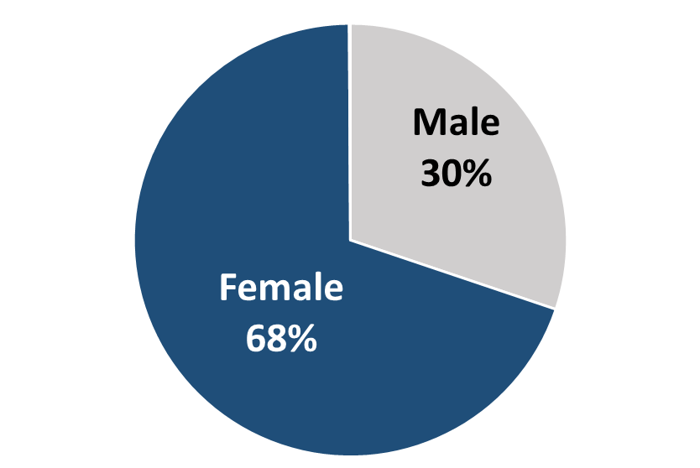
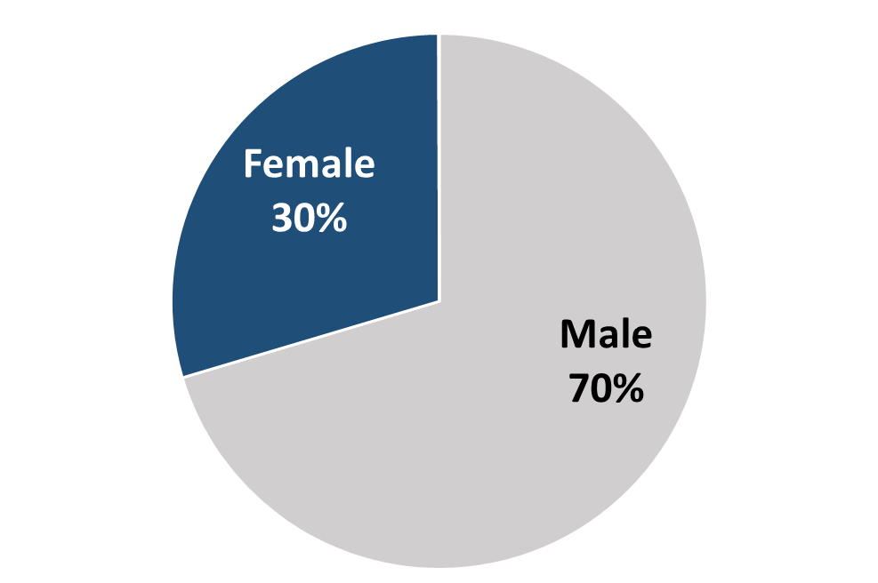
Victims and perpetrators of domestic abuse by gender
Introduction
Summary
Part 1: SIA
  Crime trends
  Abuse and exploitation
  Hate crime
  Knife crime
  Fraud and cyber crime
  Rural crime
  Road casualties
  Poverty, mental health, alcohol, drugs
  Offending and reoffending
Part 2: Serious Violence
Risk assessment - PESTELO
Finding out more
In year ending December 2021 in Oxfordshire, females remain more likely to be victims of domestic abuse and males more likely to be perpetrators, however, in each case, almost a third were of a different gender:
  30% of recorded domestic abuse victims in Oxfordshire were males
  30% of recorded suspects/offenders were females
Victims¹ of domestic abuse in Oxfordshire, by gender (Jan-Dec 2021)
Perpetrators¹ (suspects and offenders) of domestic abuse in Oxfordshire, by gender (Jan-Dec 2021)
Thames Valley Police Crime Recording System - Niche RMS; [1] Total recorded unique victims or perpetrators in the 12 month period, whether or not individuals have been a victim/perpetrator more than once
Updated

Slide 26
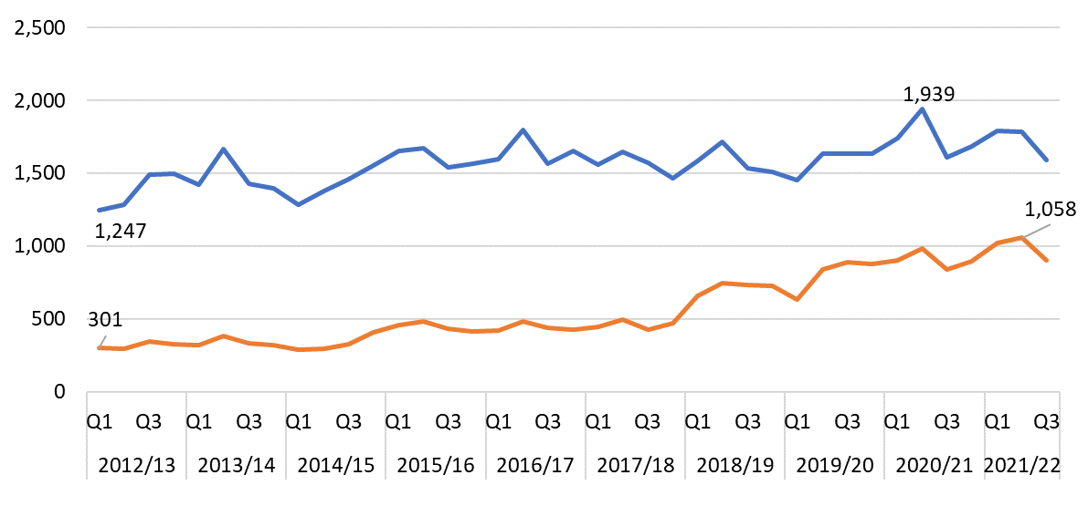
Decrease in recorded domestic abuse affecting children
Introduction
Summary
Part 1: SIA
  Crime trends
  Abuse and exploitation
  Hate crime
  Knife crime
  Fraud and cyber crime
  Rural crime
  Road casualties
  Poverty, mental health, alcohol, drugs
  Offending and reoffending
Part 2: Serious Violence
Risk assessment - PESTELO
Finding out more
Police recorded domestic crimes involving children, by district per year
 | 2019/20 | 2020/21 | 2019/20 to 2020/21 |  | Per pop
Cherwell | 884 | 825 | -59 | -7% | 0.55%
Oxford | 767 | 699 | -68 | -9% | 0.46%
South Oxfordshire | 574 | 485 | -89 | -16% | 0.34%
Vale of White Horse | 533 | 578 | 45 | 8% | 0.42%
West Oxfordshire | 480 | 399 | -81 | -17% | 0.36%
Oxfordshire | 3,238 | 2986 | -252 | -8% | 0.43%
The most recent year of data for 2020/21 has seen a fall in the number of police recorded domestic crimes involving children compared with the previous year.
Unlike other districts in Oxfordshire, Vale of White Horse district saw an increase.
The district with the highest rate per population in 2020/21 was Cherwell
Number of police recorded domestic abuse incidents and crimes involving children, Oxfordshire per quarter
Incidents
Crimes
Thames Valley Police Crime Recording System - Niche RMS NSPCC Report ONS mid-2019 population estimates from nomis

Slide 27
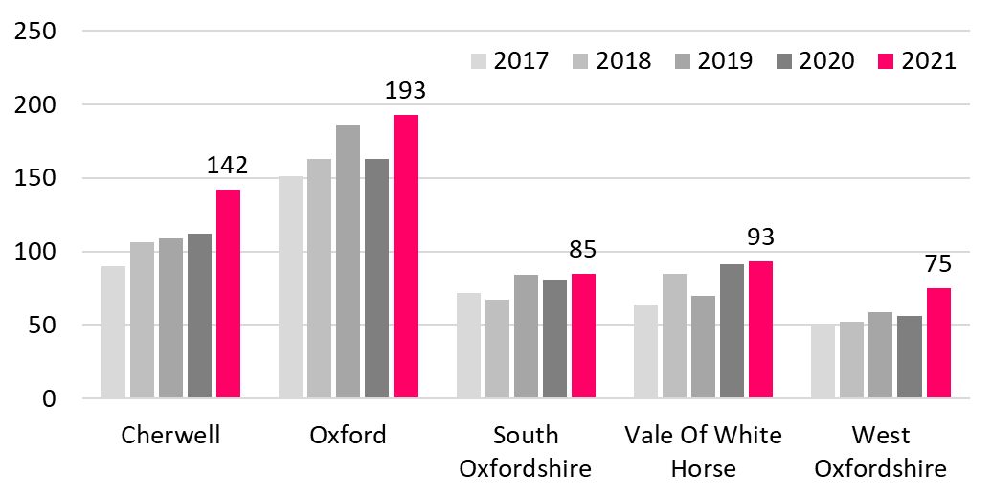
Increase in victims of rape crimes
Introduction
Summary
Part 1: SIA
  Crime trends
  Abuse and exploitation
  Hate crime
  Knife crime
  Fraud and cyber crime
  Rural crime
  Road casualties
  Poverty, mental health, alcohol, drugs
  Offending and reoffending
Part 2: Serious Violence
Risk assessment - PESTELO
Finding out more
In 2021 (Jan-Dec) Thames Valley Police recorded a total of 588 victims of rape crimes in Oxfordshire. This was 19% above the 3 year average (for the years 2018 to 2020), with the greatest increases in West Oxfordshire (+35%) and Cherwell (+30%)
90% of victims were female
61% of victims were aged under 25
Recorded victims¹ of rape crimes
Thames Valley Police Crime Recording System - Niche RMS. Year is Jan-Dec. NOTE: that police recorded rape is at the time of reporting rather than time of offence. [1] Total recorded unique victims in the 12 month period, whether or not individuals have been a victim more than once
Updated

Slide 28
Recent small increase in victims of honour based violence
Introduction
Summary
Part 1: SIA
  Crime trends
  Abuse and exploitation
  Hate crime
  Knife crime
  Fraud and cyber crime
  Rural crime
  Road casualties
  Poverty, mental health, alcohol, drugs
  Offending and reoffending
Part 2: Serious Violence
Risk assessment - PESTELO
Finding out more
In 2021 (Jan-Dec) Thames Valley Police recorded a total of 26 victims of honour-based violence in Oxfordshire, mainly in Cherwell and Oxford (see table below).
This was above the number in 2020 (24) but well below the number in 2017 (47).
TVP recorded no victims of forced marriage in Oxfordshire (none in 2018, 2019 and 2020).
Recorded victims of Honour-based violence (Crime and non Crime)
Note: According to the Crown Prosecution Service guidance:
There is no specific offence of "honour-based crime". It is an umbrella term to encompass various offences covered by existing legislation. Honour-based violence (HBV) can be described as a collection of practices, which are used to control behaviour within families or other social groups to protect perceived cultural and religious beliefs and/or honour. Such violence can occur when perpetrators perceive that a relative has shamed the family and/or community by breaking their honour code.
 | 2017 | 2018 | 2019 | 2020 | 2021 | 2020 to 2021
Cherwell | 7 | 10 | 18 | 10 | 10 | 0
Oxford | 33 | 19 | 11 | 13 | 10 | -3
South Oxfordshire | 3 | 0 | 2 | 0 | 2 | 2
Vale Of White Horse | 2 | 2 | 2 | 1 | 4 | 3
West Oxfordshire | 2 | 2 | 1 | 0 | 0 | 0
Oxfordshire | 47 | 33 | 34 | 24 | 26 | 2
Thames Valley Police Crime Recording System - Niche RMS Note: The above HBV data is a count of unique victims of offences where either the HBV Latest or HBV Finalisation qualifier has been used or the Occurrence Type or Classification has been recorded as Honour Based Violence - Non Crime Occurrence.
Updated

Slide 29
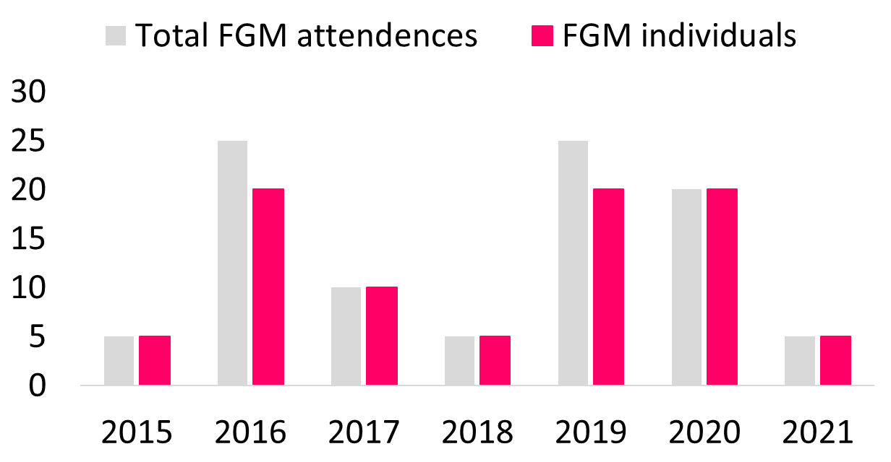
No police recorded victims of Female Genital Mutilation and drop in NHS recorded victims of FGM
Introduction
Summary
Part 1: SIA
  Crime trends
  Abuse and exploitation
  Hate crime
  Knife crime
  Fraud and cyber crime
  Rural crime
  Road casualties
  Poverty, mental health, alcohol, drugs
  Offending and reoffending
Part 2: Serious Violence
Risk assessment - PESTELO
Finding out more
Thames Valley Police recorded no victims of Female Genital Mutilation in Oxfordshire in 2021 (Jan-Dec), down from 1 in 2020;
There were between 1 and 5 women and girls who had an attendance within Oxfordshire where FGM was identified.
"Female Genital Mutilation (FGM) Quarterly Report: April 2015 – December 2021 Oxfordshire Clinical Commissioning Group
Total Attendances refers to all attendances in the reporting period where FGM was identified or a procedure for FGM was undertaken. Women and girls may have one or more attendances in the reporting period. This category includes both newly recorded and previously identified women and girls.
"A risk assessment has been carried out to assess the possibility of identifying women and girls from the publication of this data. Suppression procedures are in place to manage this risk. All values have been rounded. Values between 1 and 7 are represented as a 5. All values greater than 7 have been rounded to the nearest five."
New

Slide 30
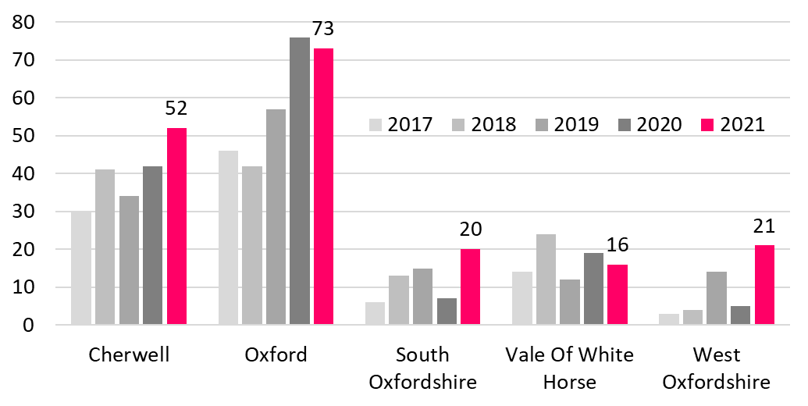
Increase in victims of Modern Slavery
Introduction
Summary
Part 1: SIA
  Crime trends
  Abuse and exploitation
  Hate crime
  Knife crime
  Fraud and cyber crime
  Rural crime
  Road casualties
  Poverty, mental health, alcohol, drugs
  Offending and reoffending
Part 2: Serious Violence
Risk assessment - PESTELO
Finding out more
In 2021 (Jan-Dec) Thames Valley Police recorded a total of 182 victims of Modern Slavery in Oxfordshire.
This was 35% above the 3 year average (for the years 2018 to 2020), with the greatest increases in the rural districts of West Oxfordshire (+174%) and South Oxfordshire (+71%)
Recorded victims¹ of Modern Slavery and Trafficking - All Occurrences (Crime and Non Crime)
According to the Home Office Modern Slavery awareness booklet Modern Slavery is a serious and often hidden crime in which people are exploited for criminal gain. The impact can be devastating for the victims.
Modern slavery comprises slavery, servitude, forced and compulsory labour and human trafficking.
There were an estimated 40 million people in slavery globally in 2016 and 10,000 –13,000 potential victims in the UK, however many victims are not identified or reported.
Thames Valley Police Crime Recording System - Niche RMS. The above data is for a count of unique victims of Modern Slavery and Trafficking offences. Modern Slavery offences have been identified where either the HO Category Number is 106 or the Modern Slavery Finalisation Qualifier has been used. Trafficking offences have been identified where either the classification or Occurrence Type has been recorded as trafficking for exploitation or sexual exploitation, into, out of or within the UK. [1] Total recorded unique victims in the 12 month period, whether or not individuals have been a victim more than once
Updated

Slide 31
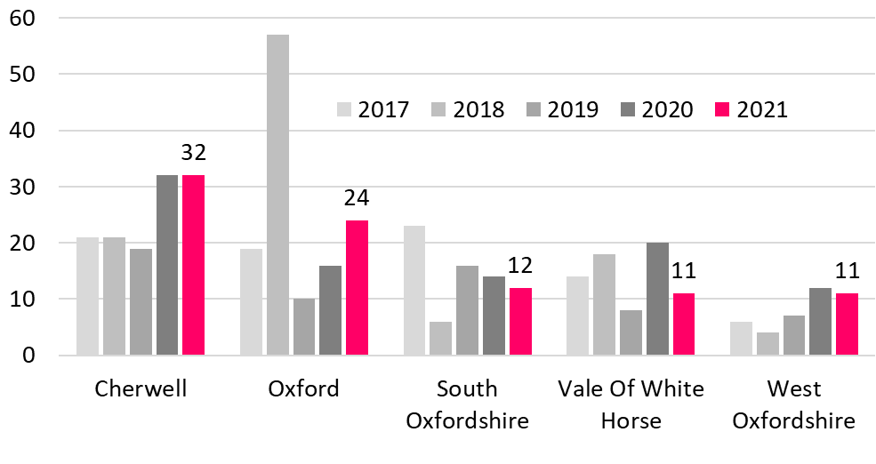
Increase in victims of Child Sexual Exploitation
Introduction
Summary
Part 1: SIA
  Crime trends
  Abuse and exploitation
  Hate crime
  Knife crime
  Fraud and cyber crime
  Rural crime
  Road casualties
  Poverty, mental health, alcohol, drugs
  Offending and reoffending
Part 2: Serious Violence
Risk assessment - PESTELO
Finding out more
In 2021 (Jan-Dec) Thames Valley Police recorded a total of 90 victims of Child Sexual Exploitation in Oxfordshire.
This was 4% above the 3 year average (for the years 2019 to 2020), with the greatest increases in West Oxfordshire (43%) and Cherwell (+33%).
Recorded victims¹ of Child Sexual Exploitation All Occurrences (Crime and Non Crime)
Note: The definition of Child Sexual Exploitation from government guidance is: Child sexual exploitation is a form of child sexual abuse. It occurs where an individual or group takes advantage of an imbalance of power to coerce, manipulate or deceive a child or young person under the age of 18 into sexual activity (a) in exchange for something the victim needs or wants, and/or (b) for the financial advantage or increased status of the perpetrator or facilitator. The victim may have been sexually exploited even if the sexual activity appears consensual. Child sexual exploitation does not always involve physical contact; it can also occur through the use of technology.
Thames Valley Police Crime Recording System - Niche RMS. The above CSE data is for all victims of offences where either the 'Child Sexual Exploitation' qualifier has been used or the Occurrence Type has been recorded as 'Suspected CSE - Non Crime Incident’ [1] Total recorded unique victims in the 12 month period, whether or not individuals have been a victim more than once
Updated

Slide 32
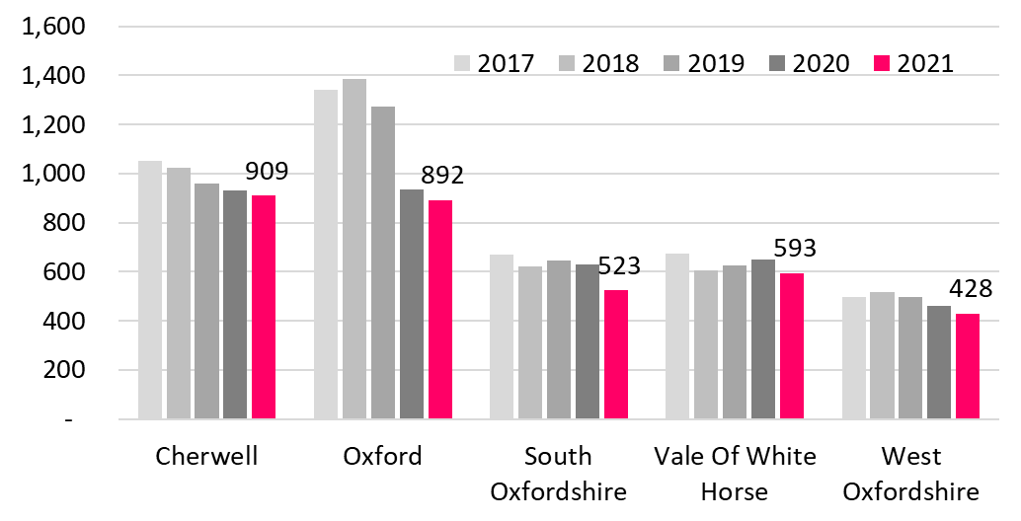
Decline in child victims of crime
Introduction
Summary
Part 1: SIA
  Crime trends
  Abuse and exploitation
  Hate crime
  Knife crime
  Fraud and cyber crime
  Rural crime
  Road casualties
  Poverty, mental health, alcohol, drugs
  Offending and reoffending
Part 2: Serious Violence
Risk assessment - PESTELO
Finding out more
In 2021 (Jan-Dec) Thames Valley Police recorded a total of 3,345 child victims (aged 0-17) of all crimes in Oxfordshire
This was 15% below the 3 year average (for the years 2018 to 2020), with the greatest falls in Oxford City (-26%) and South Oxfordshire (-17%).
Number of children (aged 0-17) recorded by Thames Valley Police as victims¹ of crime in Oxfordshire
Thames Valley Police Crime Recording System - Niche RMS. [1] Total recorded unique victims in the 12 month period, whether or not individuals have been a victim more than once
Updated

Slide 33
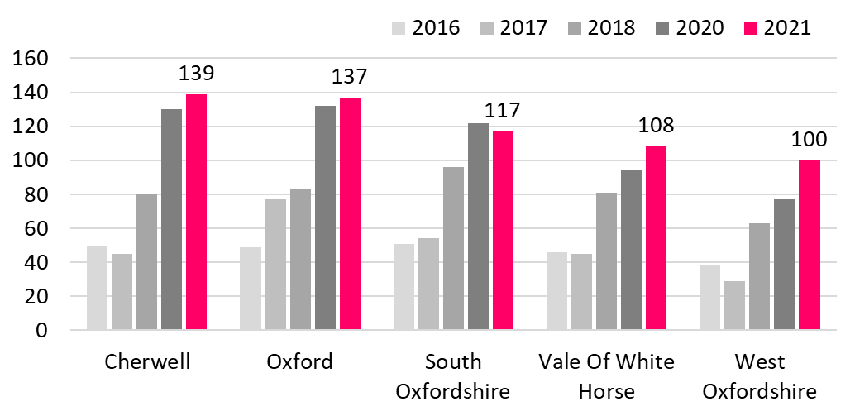
Increase in older victims of crime (violence or sexual offences)
Introduction
Summary
Part 1: SIA
  Crime trends
  Abuse and exploitation
  Hate crime
  Knife crime
  Fraud and cyber crime
  Rural crime
  Road casualties
  Poverty, mental health, alcohol, drugs
  Offending and reoffending
Part 2: Serious Violence
Risk assessment - PESTELO
Finding out more
In 2021 (Jan-Dec) Thames Valley Police recorded a total of 601 older victims (aged 65 and over) of crimes of violence or sexual offences in Oxfordshire.
This was 32% above the 3 year average (for the years 2018 to 2020), above the increase across Thames Valley (+19%) and with the greatest increases in West Oxfordshire (+44%) and Cherwell (+39%).
The increase is well above the growth in the older population in Oxfordshire.
The rate of older victims of crime per 1,000 population aged 65+ was highest in Oxford City 7.1 compared with 4.6 in Oxfordshire and 4.9 across Thames Valley)
Recorded victims¹ aged 65 or over of violence against the person or sexual offences (crimes)
Thames Valley Police Crime Recording System - Niche RMS. [1] Total recorded unique victims in the 12 month period, whether or not individuals have been a victim more than once
Updated

Slide 34
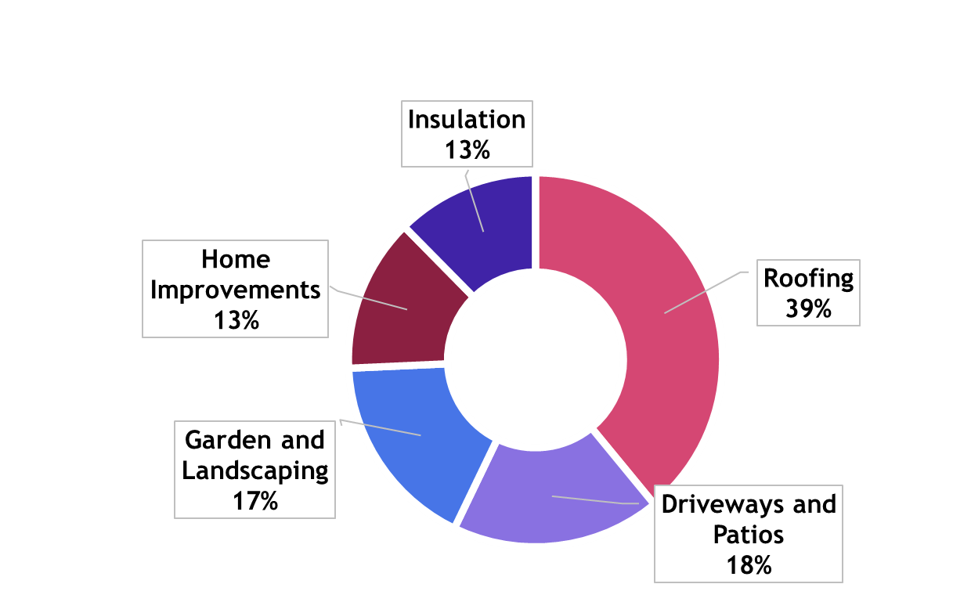
Decline in number of victims of doorstep crime
Introduction
Summary
Part 1: SIA
  Crime trends
  Abuse and exploitation
  Hate crime
  Knife crime
  Fraud and cyber crime
  Rural crime
  Road casualties
  Poverty, mental health, alcohol, drugs
  Offending and reoffending
Part 2: Serious Violence
Risk assessment - PESTELO
Finding out more
In 2021-22 there were 147 victims of doorstep crime or rogue traders in Oxfordshire, down from 165 in the previous year, a fall of 11% (-18).
The most likely reason for a decrease in victims is a reduction in resource to the doorstep crime team from 2016 onwards.
In 2021-22 there was an increase in the monies paid by victims.
Oxfordshire victims paid out £1.2 million to unscrupulous traders
The majority of victims continue to be elderly residents.
Top 5 Goods Service Areas used by rogue traders in Oxfordshire 2021-22
Oxfordshire County Council Trading Standards
Updated

Slide 35
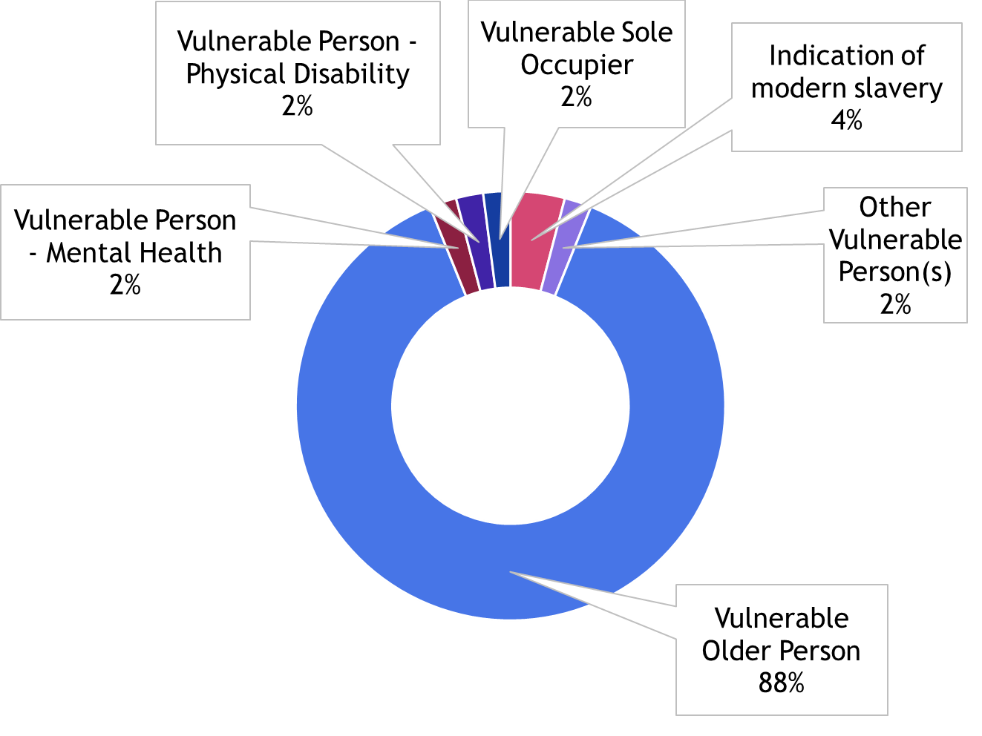
Majority of recorded doorstep crime victims were vulnerable older people
Introduction
Summary
Part 1: SIA
  Crime trends
  Abuse and exploitation
  Hate crime
  Knife crime
  Fraud and cyber crime
  Rural crime
  Road casualties
  Poverty, mental health, alcohol, drugs
  Offending and reoffending
Part 2: Serious Violence
Risk assessment - PESTELO
Finding out more
12 months of data (01/01/2021 – 31/02/2021) from Trading Standards highlights the tactics used by doorstep criminals.
30% (48) of intelligence reports in 2021 had information relating to the victim.
Unfortunately, due to lack of recording or insufficient information there are 113 intelligence reports that had no victim details.
88% of victims of doorstep crime recorded (43) were a ‘vulnerable older person’.
78 intelligence reports provided a description of business practice (modus operandi of the criminality). Total 280 descriptions provided (one intelligence report can have multiple business practices). Charging more than agreed/advertised was the most commonly used tactic (25% n.70).
Victim description as % of those recorded (2021)
Trading Standards – Community Safety IDB (Intelligence Database)
Updated

Slide 36
Hate crime

Slide 37
Increases in police recorded hate crime driven by improvements in crime recording
Introduction
Summary
Part 1: SIA
  Crime trends
  Abuse and exploitation
  Hate crime
  Knife crime
  Fraud and cyber crime
  Rural crime
  Road casualties
  Poverty, mental health, alcohol, drugs
  Offending and reoffending
Part 2: Serious Violence
Risk assessment - PESTELO
Finding out more
Hate crime is defined as ‘any criminal offence which is perceived, by the victim or any other person, to be motivated by hostility or prejudice towards someone based on a personal characteristic.’
This common definition was agreed in 2007 by the police, Crown Prosecution Service, Prison Service (now the National Offender Management Service) and other agencies that make up the criminal justice system.
There are five centrally monitored strands of hate crime:
  race or ethnicity
  religion or beliefs
The Home Office October 2021 hate crime statistical bulletin reports that:
  Increases in police recorded hate crime in recent years have been driven by improvements in crime recording and a better identification of what constitutes a hate crime.
  As in previous years, the majority of hate crimes were racially motivated, accounting for around three-quarters of such offences (74%; 85,268 offences); these types of hate crime increased by 12 per cent between year ending March 2020 and year ending March 2021
  The CSEW is a face-to-face victimisation survey and also provides information on hate crimes experienced by people resident in England and Wales. Estimates from the survey were last published in ‘Hate Crime, England and Wales, 2019 to 2020’. The next publication of figures from the CSEW would have been due in 2023, but this may be delayed due to the COVID-19 pandemic
  sexual orientation
  disability
  transgender identity
Hate crime, England and Wales, 2020 to 2021 - GOV.UK (www.gov.uk)
Updated

Slide 38
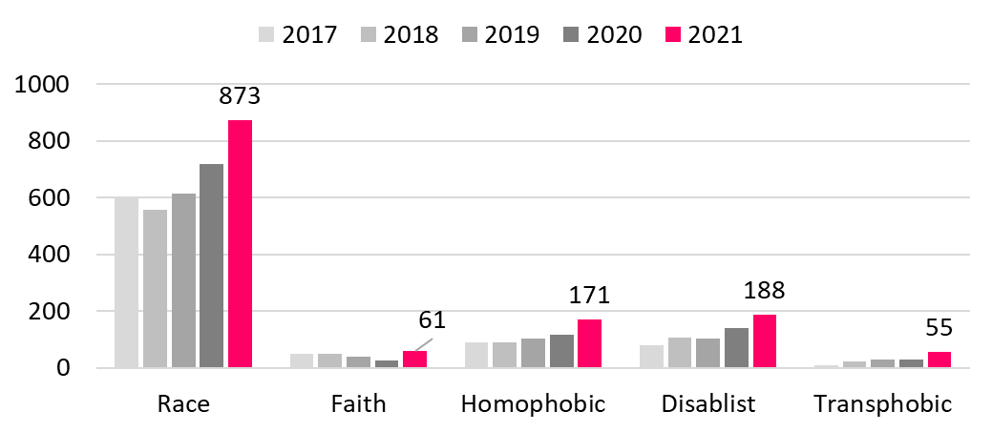
Increase in recorded victims of hate crime in Oxfordshire
Introduction
Summary
Part 1: SIA
  Crime trends
  Abuse and exploitation
  Hate crime
  Knife crime
  Fraud and cyber crime
  Rural crime
  Road casualties
  Poverty, mental health, alcohol, drugs
  Offending and reoffending
Part 2: Serious Violence
Risk assessment - PESTELO
Finding out more
In year ending December 2021, Thames Valley Police recorded a total of 1,262 victims of hate crime (crime and non-crime occurrences) in Oxfordshire.
This was a 44% increase in 2021 compared with the average of the previous 3 years (2018-20), likely to have been affected by improvements in recording. Across Thames Valley the increase was 30%.
Recorded victims of hate crime offences in Oxfordshire (all occurrences)
Thames Valley Police Crime Recording System - Niche RMS extracted 08/02/22 Notes: The data counts people who have been victims of hate crime on multiple occasions as one individual. However someone may be a victim of an offence where multiple hate crime qualifiers have been applied, i.e. someone could be a victim of an occurrence where both the Race and Faith qualifiers have been applied to the occurrence, therefore this will reflect in the figures for both qualifiers. “Victim” of a hate crime may be an organisation i.e. racist graffiti on council property will not have a person listed as a victim.
Updated

Slide 39
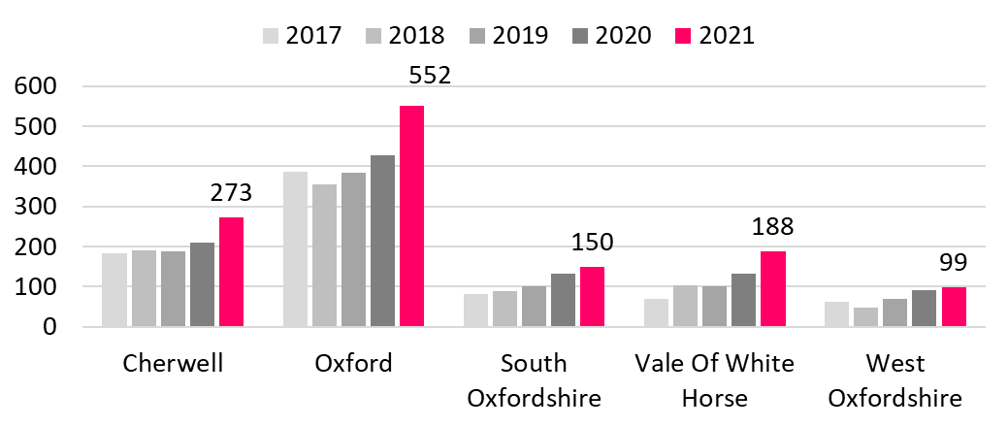
Greatest % increase in recorded victims of hate crime in Vale of White Horse
Introduction
Summary
Part 1: SIA
  Crime trends
  Abuse and exploitation
  Hate crime
  Knife crime
  Fraud and cyber crime
  Rural crime
  Road casualties
  Poverty, mental health, alcohol, drugs
  Offending and reoffending
Part 2: Serious Violence
Risk assessment - PESTELO
Finding out more
All districts in Oxfordshire saw an increase in recorded victims of hate crime occurrences (Dec21 compared with 3 year average 2018-20), with the greatest increase in Vale of White Horse (+67%), compared with +44% for Oxfordshire overall
Recorded victims of hate crime offences by district (all occurrences)
Thames Valley Police Crime Recording System - Niche RMS extracted 08/02/22 Notes: The data counts people who have been victims of hate crime on multiple occasions as one individual. However someone may be a victim of an offence where multiple hate crime qualifiers have been applied, i.e. someone could be a victim of an occurrence where both the Race and Faith qualifiers have been applied to the occurrence, therefore this will reflect in the figures for both qualifiers. “Victim” of a hate crime may be an organisation i.e. racist graffiti on council property will not have a person listed as a victim.
Updated

Slide 40
Profile of victims of hate crime
Introduction
Summary
Part 1: SIA
  Crime trends
  Abuse and exploitation
  Hate crime
  Knife crime
  Fraud and cyber crime
  Rural crime
  Road casualties
  Poverty, mental health, alcohol, drugs
  Offending and reoffending
Part 2: Serious Violence
Risk assessment - PESTELO
Finding out more
In year ending Dec 2021, demographic details of recorded victims of all types of hate crime (all occurrences) in Oxfordshire shows…
By gender
  49% of hate crime victims were males and 42% were females (9% not recorded).
By age
  78% of hate crime victims were aged 18 to 64
  8% were children and young people aged 0-17 and a further 10% were aged 18-24
  4% were older people aged 65 and over
By ethnic background
  It is not possible to present data by ethnic background as three quarters of victims (75%) did not have an ethnic group recorded
Thames Valley Police Crime Recording System - Niche RMS extracted 08/02/22 Notes: The data counts people who have been victims of hate crime on multiple occasions as one individual. However someone may be a victim of an offence where multiple hate crime qualifiers have been applied, i.e. someone could be a victim of an occurrence where both the Race and Faith qualifiers have been applied to the occurrence, therefore this will reflect in the figures for both qualifiers. “Victim” of a hate crime may be an organisation i.e. racist graffiti on council property will not have a person listed as a victim.
Updated

Slide 41
Knife crime

Slide 42
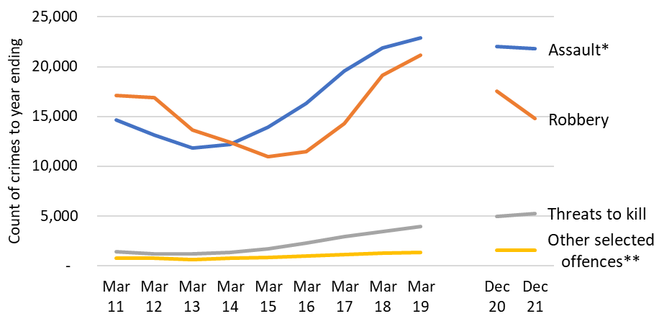
Nationally incidents of police recorded knife-enabled crime decreased for the second consecutive year
Introduction
Summary
Part 1: SIA
  Crime trends
  Abuse and exploitation
  Hate crime
  Knife crime
  Fraud and cyber crime
  Rural crime
  Road casualties
  Poverty, mental health, alcohol, drugs
  Offending and reoffending
Part 2: Serious Violence
Risk assessment - PESTELO
Finding out more
National ONS data shows that knife-enabled crime recorded by the police saw a 4% decrease driven by a 15% decrease in robbery offences.
Levels of knife-enabled crime were lower during periods of lockdown but returned to pre-coronavirus (COVID-19) levels in the April to December 2021 period. Despite this, knife-enabled crime was still 10% lower in the year ending December 2021 compared with the pre-coronavirus year ending March 2019.
Knife-enabled crime England and Wales
Crime in England and Wales - Office for National Statistics (ons.gov.uk)
Excludes data from Greater Manchester Police.
*Assault with injury and assault with intent to cause serious harm
**includes rape, attempted murder, homicide and sexual assault
New

Slide 43
Just over a quarter of possession of knife offences involved young people
Introduction
Summary
Part 1: SIA
  Crime trends
  Abuse and exploitation
  Hate crime
  Knife crime
  Fraud and cyber crime
  Rural crime
  Road casualties
  Poverty, mental health, alcohol, drugs
  Offending and reoffending
Part 2: Serious Violence
Risk assessment - PESTELO
Finding out more
For the calendar year January to December 2021, there were 139 perpetrators involved in possession of knife offences in Oxfordshire
Of these 38 (27%) were young people aged under 18
Perpetrators of Possession of an article with a blade or point
Offences recorded in Oxfordshire Jan-Dec 2021
 | 0-17 | 18 and over | Age not Recorded | Total
Cherwell | 7 | 24 | 0 | 31
Oxford | 15 | 39 | 0 | 54
South Oxfordshire | 4 | 10 | 0 | 14
Vale of White Horse | 7 | 19 | 0 | 26
West Oxfordshire | 5 | 8 | 1 | 14
Oxfordshire | 38 | 100 | 1 | 139
Data Source: Thames Valley Police Crime System - Niche
Note: The above data is for suspects/offenders of valid crimes recorded under HO Category Number 10D - this will be classifications of; Possession of Article with Blade or Point', 'Having an article with a blade or point in a public place', 'Having an article with a blade or point on school premises', 'Threaten with an article with a blade or point in a public place' and 'Threaten with an article with a blade or point on school premises'.
New

Slide 44
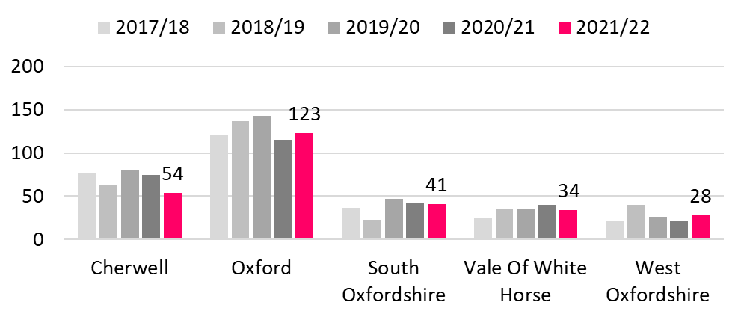
Decline in victims of knife crime in Oxfordshire
Introduction
Summary
Part 1: SIA
  Crime trends
  Abuse and exploitation
  Hate crime
  Knife crime
  Fraud and cyber crime
  Rural crime
  Road casualties
  Poverty, mental health, alcohol, drugs
  Offending and reoffending
Part 2: Serious Violence
Risk assessment - PESTELO
Finding out more
In 2021/22 (Apr-Mar) Thames Valley Police recorded a total of 280 victims of knife crime offences in Oxfordshire.
This was 9% below the previous 3 year average (for the years 2018/19 to 2020/21).
Oxford City saw a fall of 26%.
Source: Thames Valley Police Crime Recording System - Niche RMS extracted April 2021. Note: the information is for knife crime offence that meet the Home Office definition. These are certain violent offences, sexual offences and robbery offences where a sharp, pointed or bladed instrument has been used to pierce the skin or used as a threat.
[1] Total recorded unique victims in the 12 month period, whether or not individuals have been a victim more than once
This data is only available for financial year.
Victims¹ of violent, sexual and robbery offences recorded in Oxfordshire where a sharp or bladed implement was linked to the offence as a weapon (financial year)
Updated

Slide 45
Knife crimes – victims and perpetrators by gender and age
Introduction
Summary
Part 1: SIA
  Crime trends
  Abuse and exploitation
  Hate crime
  Knife crime
  Fraud and cyber crime
  Rural crime
  Road casualties
  Poverty, mental health, alcohol, drugs
  Offending and reoffending
Part 2: Serious Violence
Risk assessment - PESTELO
Finding out more
In year ending March 2022, demographic details of recorded victims and perpetrators of knife crime in Oxfordshire shows…
By gender
68% of knife crime VICTIMS were males and 31% were females (0% not recorded).
76% of knife crime PERPETRATORS were males and 24% were females
VICTIMS by age
81% of knife crime victims were aged 18 to 64
18% were children and young people aged 0-17 and a further 26% were aged 18-24
1% were older people aged 65 and over
PERPETRATORS by age
78% of knife crime perpetrators were aged 18 to 64
20% were children and young people aged 0-17 and a further 23% were aged 18-24
1% were older people aged 65 and over
Source: Thames Valley Police Crime Recording System - Niche RMS extracted April 2022. Note: the above information is for knife crime offence that meet the Home Office definition. These are certain violent offences, sexual offences and robbery offences where a sharp, pointed or bladed instrument has been used to pierce the skin or used as a threat. Total recorded unique victims in the 12 month period, whether or not individuals have been a victim more than once. ONS Census 2011 table KS201 from nomis
Updated

Slide 46
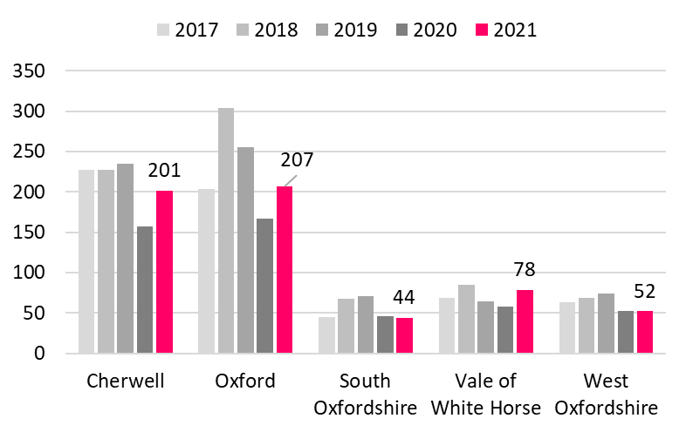
Decline in use of hospital services as a result of knife crime
Introduction
Summary
Part 1: SIA
  Crime trends
  Abuse and exploitation
  Hate crime
  Knife crime
  Fraud and cyber crime
  Rural crime
  Road casualties
  Poverty, mental health, alcohol, drugs
  Offending and reoffending
Part 2: Serious Violence
Risk assessment - PESTELO
Finding out more
Most people with knife injuries would attend the emergency department rather than as an inpatient. There is no recording of knife assaults within ED.
The following data is for people attending following an “assault with a sharp object”
In 2021 (Jan-Dec) Oxford University Hospitals NHS Foundation Trust recorded a total of:
  582 Oxfordshire residents attending Accident and Emergency units following an assault with a sharp object, 207 residents of Oxford City (36%) and 201 from Cherwell (35%)
  28 Oxfordshire residents admitted as an in-patient following an assault with a sharp object
Assault by sharp object admissions Emergency Department (calendar year)
Source: Oxford University Hospitals NHS Foundation Trust; UK Parliament: Knife Crime Statistics
New

Slide 47
Fraud and cyber-related crime

Slide 48
Impact of COVID-19 on fraud (national)
Introduction
Summary
Part 1: SIA
  Crime trends
  Abuse and exploitation
  Hate crime
  Knife crime
  Fraud and cyber crime
  Rural crime
  Road casualties
  Poverty, mental health, alcohol, drugs
  Offending and reoffending
Part 2: Serious Violence
Risk assessment - PESTELO
Finding out more
According to ONS
Fraud estimates do not follow the trend of falling victimisation seen in other crime types. Estimates from the Crime Survey for England and Wales show a 41% increase in fraud offences between year ending Dec19 and Dec21.
There were large increases in “advance fee fraud”, “consumer and retail fraud”. This may be an indication fraudsters took advantage of behaviour changes relating to the Covid-19 pandemic, such as online shopping.
Action Fraud (the public-facing national fraud and cybercrime reporting centre) reported a 15% rise in fraud offences (to 400,763 offences) compared with the year ending December 2020.
The data showed a 29% increase in “financial investment fraud” offences in the last year (to 22,683 offences) and an 12% rise in “advance fee payments” (to 51,667 offences).
NFIB data showed referrals from UK Finance and Cifas (who report instances of fraud where their member organisations have been victims) increased by 78% (to 190,327 offences) and 10% (to 329,442 offences), respectively, compared with the year ending December 2020.
Updated

Slide 49
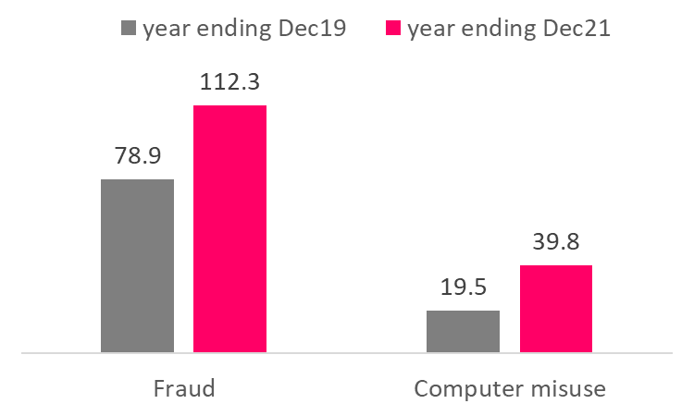
Significant increases in fraud and computer misuse
Introduction
Summary
Part 1: SIA
  Crime trends
  Abuse and exploitation
  Hate crime
  Knife crime
  Fraud and cyber crime
  Rural crime
  Road casualties
  Poverty, mental health, alcohol, drugs
  Offending and reoffending
Part 2: Serious Violence
Risk assessment - PESTELO
Finding out more
According to ONS, between year ending December 2019 and December 2021, the estimated number of fraud offences increased by 41% and the number of computer misuse offences doubled.
Within the category of fraud, large increases were seen in “advance fee fraud” and “consumer and retail fraud”. This is likely to be linked to increases in online shopping e.g. scams where victims transferred funds to fraudsters for postal deliveries.
The biggest increase in computer misuse offences was in “Unauthorised access to personal information (including hacking)”.
Rate of total Fraud and Computer misuse offences per 1,000 adults from Crime Survey for England and Wales*
Fraud involves a person dishonestly and deliberately deceiving a victim for personal gain of property or money or causing loss or risk of loss to another.
Most incidents include:
banking and payment card frauds
consumer and retail frauds
advance fee payment frauds
Computer misuse covers computer viruses and any unauthorised access to computer material including smartphones, games consoles and smart TVs.
*Note differences in methodology. The 2019 survey was face-to-face interviews and the 2021 data was a phone survey
ONS Crime in England and Wales, year ending December 2021 - Appendix tables experimental statistics
Updated

Slide 50
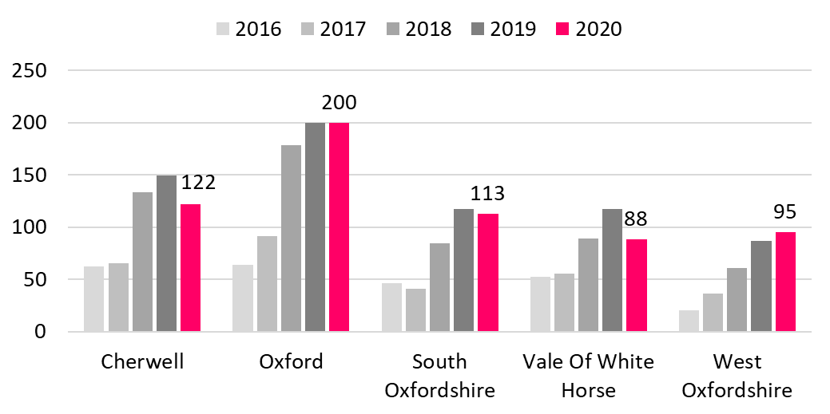
Work underway to review levels of fraud in Oxfordshire
Introduction
Summary
Part 1: SIA
  Crime trends
  Abuse and exploitation
  Hate crime
  Knife crime
  Fraud and cyber crime
  Rural crime
  Road casualties
  Poverty, mental health, alcohol, drugs
  Offending and reoffending
Part 2: Serious Violence
Risk assessment - PESTELO
Finding out more
NOTE: It is not yet possible to update local data on fraud offences in Oxfordshire and work is underway to review these statistics
As reported in the previous 2021 Oxfordshire Strategic Intelligence Assessment: between Dec19 and Dec20 the number of fraud offences in Oxfordshire fell by 8% compared with a drop of 15% across Thames Valley
Fraud offences recorded by Thames Valley Police (passed from Action Fraud as requiring further action)
Source: Thames Valley Police Crime Recording System - Niche RMS, January 2021; Note: the above data is for all occurrences that have been reported under the occurrence type of Action Fraud - Call For Service and Action Fraud - NFIB Referral
Unchanged

Slide 51

Residents reporting scams in Oxfordshire remains about pre-pandemic levels
Introduction
Summary
Part 1: SIA
  Crime trends
  Abuse and exploitation
  Hate crime
  Knife crime
  Fraud and cyber crime
  Rural crime
  Road casualties
  Poverty, mental health, alcohol, drugs
  Offending and reoffending
Part 2: Serious Violence
Risk assessment - PESTELO
Finding out more
The Covid pandemic has accelerated change in the consumer protection landscape. Some of the more traditional scams such as doorstep crime were curtailed by the imposed lockdown restrictions. Criminals adapted quickly, which has led to a surge in different tactics being deployed by scammers, who have sought to exploit social change and evolving technology. UK Finance has reported that so-called ‘impersonation scams’ have doubled as criminals pretend to be from banks, delivery firms or the government to dupe consumers and businesses.
Oxfordshire residents reporting scams
The number of scams reported by Oxfordshire residents increased significantly during the COVID-19 pandemic
Data ending December 2021 indicate levels remain higher than pre-COVID
These scams relate to ‘bogus selling’ which can be via unsolicited phone call, unsolicited mail or email.
Start of lockdown
Action Fraud, National Trading Standards, Citizens Advice data for ‘bogus selling’ Oxfordshire consumers
Updated

Slide 52
Nationally - cyber crime makes up almost a quarter of harassment and stalking offences
Introduction
Summary
Part 1: SIA
  Crime trends
  Abuse and exploitation
  Hate crime
  Knife crime
  Fraud and cyber crime
  Rural crime
  Road casualties
  Poverty, mental health, alcohol, drugs
  Offending and reoffending
Part 2: Serious Violence
Risk assessment - PESTELO
Finding out more
Cyber crime is an umbrella term used to describe two closely linked, but distinct ranges of criminal activity. The Government's National Cyber Security Strategy (published in November 2016) defines them as:
1.Cyber-dependent crimes - crimes that can be committed only through the use of Information and Communications Technology (ICT) devices, where the devices are both the tool for committing the crime, and the target of the crime.
2.Cyber-enabled crimes - traditional crimes which can be increased in scale or reach by the use of computers, computer networks or other forms of ICT.
In year ending Dec21, online crime was flagged for 63% of Obscene Publication offences and 50% of Blackmail offences
The greatest volume was in the category of “harassment and stalking” where online crime was flagged in 23% of offences
Offences flagged as online crime, year ending Dec 21 (England and Wales)
Grouping | Number of offences flagged as online crime | Proportion of total offences flagged as online crime (%)
Harassment and stalking | 154,923 | 23
Obscene publications | 21,568 | 63
Child sexual offences | 13,039 | 20
Blackmail | 10,442 | 50
Other violence against the person offences | 6,648 | 0
Public order offences | 5,659 | 1
Sexual offences (exc. child sexual offences) | 1,187 | 1
Criminal damage and arson | 923 | 0
Other offences | 7,926 | 0
Total | 222,315 | 4
Source: ONS Dec 2021
New

Slide 53

Increase in Cyber Crime in Oxfordshire
Introduction
Summary
Part 1: SIA
  Crime trends
  Abuse and exploitation
  Hate crime
  Knife crime
  Fraud and cyber crime
  Rural crime
  Road casualties
  Poverty, mental health, alcohol, drugs
  Offending and reoffending
Part 2: Serious Violence
Risk assessment - PESTELO
Finding out more
In year ending Dec21, Thames Valley Police recorded a total of 1,202 Cyber-related offences in Oxfordshire, an increase on the number recorded in 2020 (1,085, +16%).
Between 2020 and 2021, Oxford, South Oxfordshire, Vale of White Horse and West Oxfordshire districts each saw an increase in cyber-related offences. Cherwell however saw a decrease (-13%).
Cyber-related Offences (Crime and Non-Crime) Oxfordshire
*
Source: Thames Valley Police Crime Recording System - Niche RMS, Feb22
*Note that, of the 381 offences recorded in South Oxfordshire in 2018, 287 of those were linked to one person who was responsible for indecent images/sexual activity offences with a lot of different people, committed on-line.
Updated

Slide 54

Just over 1 in 10 cyber-related offences were linked to domestic abuse
Introduction
Summary
Part 1: SIA
  Crime trends
  Abuse and exploitation
  Hate crime
  Knife crime
  Fraud and cyber crime
  Rural crime
  Road casualties
  Poverty, mental health, alcohol, drugs
  Offending and reoffending
Part 2: Serious Violence
Risk assessment - PESTELO
Finding out more
Of the 1,202 cyber-related offences in Oxfordshire in year ending Dec21, 11.3% (136) were related to domestic abuse occurrences (crime and non-crime).
Total cyber-related occurrences and domestic cyber-related occurrences (Crime and Non-Crime) Oxfordshire
Source: Thames Valley Police Crime Recording System - Niche RMS, Feb22
Note: The above data is for all occurrences of Cyber related offences where the Cyber Crime Qualifier has been used. Data has also been provided for those cyber related occurrences which also have the Domestic Abuse qualifiers attached to the occurrence.
Updated

Slide 55
Rural crime

Slide 56

Increase in rural crime
Introduction
Summary
Part 1: SIA
  Crime trends
  Abuse and exploitation
  Hate crime
  Knife crime
  Fraud and cyber crime
  Rural crime
  Road casualties
  Poverty, mental health, alcohol, drugs
  Offending and reoffending
Part 2: Serious Violence
Risk assessment - PESTELO
Finding out more
Rural crime is defined as an offence that relates to farms, agriculture, wildlife, the environment and heritage sites where they are targeted due to their isolation or rural location.
In year ending Dec21, Thames Valley Police recorded a total of 548 rural crimes in Oxfordshire, above the number recorded in 2020 (424). This change may be a result of changes in recording.
Number of recorded rural crimes in Oxfordshire (Jan-Dec)
Thames Valley Police Crime Recording System - Niche RMS extracted February 2022. *Rural Crime Data is now based on the definition that came into effect on 1st April 2021. The definition is now more in line with other leading forces in Rural Crime and was developed by practitioners to reflect the diverse nature of rural crime offences. Due to the change in definition data produced now may differ to any previous figures provided.
Updated

Slide 57

Top rural crime was criminal damage
Introduction
Summary
Part 1: SIA
  Crime trends
  Abuse and exploitation
  Hate crime
  Knife crime
  Fraud and cyber crime
  Rural crime
  Road casualties
  Poverty, mental health, alcohol, drugs
  Offending and reoffending
Part 2: Serious Violence
Risk assessment - PESTELO
Finding out more
In addition to the 548 rural crimes recorded in Oxfordshire in 2021, there were 399 non-crime offences.
Rural crime in Oxfordshire by crime and non-crime (Jan-Dec20)
 | Recorded Crime | Non Crime Occurrence | Total Occurrences
Cherwell | 89 | 55 | 144
Oxford | 5 | 7 | 12
South Oxfordshire | 212 | 163 | 375
Vale Of White Horse | 140 | 100 | 240
West Oxfordshire | 102 | 74 | 176
Oxfordshire Total | 548 | 399 | 947
Top 5 crime group categories in Oxfordshire (recorded crime only)
The top sub-category for rural crime in Oxfordshire in 2021, was Criminal Damage (176)
Thames Valley Police Crime Recording System - Niche RMS extracted February 2022
Updated

Slide 58
Road casualties

Slide 59
Decrease in overall police-reported road casualties
Introduction
Summary
Part 1: SIA
  Crime trends
  Abuse and exploitation
  Hate crime
  Knife crime
  Fraud and cyber crime
  Rural crime
  Road casualties
  Poverty, mental health, alcohol, drugs
  Offending and reoffending
Part 2: Serious Violence
Risk assessment - PESTELO
Finding out more
In 2021, there was a total of 1,014 police-reported road casualties in Oxfordshire of which 230 were the more serious “killed or seriously injured” (KSI). This was a decline of 6% on the number in 2020 (1,082 in total, including 225 KSI) .
Child (aged 0-15) casualties increased from 53 in 2020 to 83 in 2021. Children Killed or Seriously Injured increased slightly from 16 in 2020 to 19 in 2021, although there were 0 fatal casualties in this age group, down from 4 (2 male & 2 female) the previous year.
Source: Oxfordshire County Council Traffic and Road Safety
Updated

Slide 60
Decline in Killed or Seriously Injured for all vehicle types
Introduction
Summary
Part 1: SIA
  Crime trends
  Abuse and exploitation
  Hate crime
  Knife crime
  Fraud and cyber crime
  Rural crime
  Road casualties
  Poverty, mental health, alcohol, drugs
  Offending and reoffending
Part 2: Serious Violence
Risk assessment - PESTELO
Finding out more
The split of Killed and Seriously Injured (KSI) casualties by vehicle type in Oxfordshire in 2021 was 37% car driver or car passenger (same as in 2020), 23% pedal cycle (22% in 2020), 21% motorcycle (19% in 2020) and 13% pedestrian (11% in 2020).
Compared with the average for 2010-14, KSI causalities have continued to decline steadily for all vehicle types, whilst reductions can be seen when compared with the 2019 figures – although the numbers from pedal cyclist have seen only minimal change.
Killed and Seriously Injured casualties by vehicle type
2010 - 2021 in Oxfordshire
Source: Oxfordshire County Council Traffic and Road Safety
Updated

Slide 61

Road Traffic Collisions attended by Oxfordshire Fire and Rescue impacted by COVID-19 lockdown
Introduction
Summary
Part 1: SIA
  Crime trends
  Abuse and exploitation
  Hate crime
  Knife crime
  Fraud and cyber crime
  Rural crime
  Road casualties
  Poverty, mental health, alcohol, drugs
  Offending and reoffending
Part 2: Serious Violence
Risk assessment - PESTELO
Finding out more
The number of attended Road Traffic Collisions is seasonal, with higher numbers in October to December.
Between April and June 2020, the coronavirus lockdown caused a dip in road collisions as a result of far less traffic on the roads (dotted line).
Number of Road Traffic Collisions attended by Oxfordshire Fire & Rescue by month and year April to March
Oxfordshire Fire and Rescue - IRS
Updated

Slide 62

Emergency hospital admissions for pedal cyclists aged 0-24 has remained above average
Introduction
Summary
Part 1: SIA
  Crime trends
  Abuse and exploitation
  Hate crime
  Knife crime
  Fraud and cyber crime
  Rural crime
  Road casualties
  Poverty, mental health, alcohol, drugs
  Offending and reoffending
Part 2: Serious Violence
Risk assessment - PESTELO
Finding out more
Oxfordshire has remained above the national average on emergency hospital admissions for pedal cyclists aged 0-24, although the gap has narrowed.
  Between 2016/17 and 2020/21, the 5 year total count of emergency admissions for pedal cyclists aged 0-24 in Oxfordshire was 175
  This was a rate per 100,000 population of 16.5, above the South East average of 13.9 and above the England average of 13.0.
Emergency admissions for pedal cyclists (aged 0-24) 5 year rolling average rate per 100,000
Public health profiles - OHID (phe.org.uk)
Updated

Slide 63
Below average alcohol-related road traffic accidents
Introduction
Summary
Part 1: SIA
  Crime trends
  Abuse and exploitation
  Hate crime
  Knife crime
  Fraud and cyber crime
  Rural crime
  Road casualties
  Poverty, mental health, alcohol, drugs
  Offending and reoffending
Part 2: Serious Violence
Risk assessment - PESTELO
Finding out more
In the last six-year period 2016 to 2021, there was 230 road traffic accidents in Oxfordshire where at least one driver either failed an alcohol breath test or refused to provide a sample when requested.
This latest data puts Oxfordshire below the national average on the crude rate of alcohol-related road traffic accidents (per 1,000 accidents), although both follow a similar trend pattern up to 2018, however Oxfordshire saw a large decrease in 2019, and overall compares similarly to Oxfordshire’s statistical neighbours. National data post 2019 is currently unavailable, and therefore further comparison isn’t possible.
Group | 2016 | 2017 | 2018 | 2019 | 2020 | 2021
All Accidents (Oxon) | 1,502 | 1,293 | 1,153 | 1,102 | 864 | 844
Breath Test Accidents (Oxon) | 54 | 47 | 48 | 34 | 26 | 21
Breath Test Accs per 1000 Accs (Oxon) | 35.95 | 36.35 | 41.63 | 30.85 | 30.09 | 24.88
All Accidents (GB) | 136,621 | 129,982 | 122,635 | 117,536 | no data
Drink Drive Accidents (GB) | 6,070 | 5,700 | 5,900 | 5400
Drink Drive Accs per 1000 Accs (GB) | 44.43 | 43.85 | 48.11 | 45.94
Source: Oxfordshire County Council Traffic and Road Safety
Updated

Slide 64
Poverty, mental health, alcohol and drugs

Slide 65


People in poverty more likely to live in areas with higher rates of crime
Introduction
Summary
Part 1: SIA
  Crime trends
  Abuse and exploitation
  Hate crime
  Knife crime
  Fraud and cyber crime
  Rural crime
  Road casualties
  Poverty, mental health, alcohol, drugs
  Offending and reoffending
Part 2: Serious Violence
Risk assessment - PESTELO
Finding out more
In Oxfordshire in 2021, total recorded crime was over 2.5 times more prevalent in the most income-deprived 20% of areas compared with the least income-deprived 10%.
Violence and sexual offences were 3.6 times more prevalent in the most income-deprived 20% of areas compared with the least income-deprived 10%. The gap is similar to 2019, before the COVID-19 pandemic.
Oxfordshire rate of All Recorded Crime Jan-Dec2021 by income deprivation decile
Oxfordshire rate of Recorded Violence and sexual offences Jan-Dec2021
by income deprivation decile
167.2
74.7
Rate per 1,000 population
Rate per 1,000 population
62.5
20.6
Decile by income deprivation (IMD 2019)
Decile by income deprivation (IMD 2019)
From data.police.uk and IMD 2019 MHCLG. Oxfordshire has 14 out of 407 areas in 20% most deprived on income deprivation in parts of Banbury, south east Oxford, Barton and one part of Abingdon (and no areas in the 10% most deprived). To explore this data visit our interactive dashboard
New

Slide 66


Higher rates of crime associated with higher density shopping areas and areas of deprivation
Introduction
Summary
Part 1: SIA
  Crime trends
  Abuse and exploitation
  Hate crime
  Knife crime
  Fraud and cyber crime
  Rural crime
  Road casualties
  Poverty, mental health, alcohol, drugs
  Offending and reoffending
Part 2: Serious Violence
Risk assessment - PESTELO
Finding out more
Shopping areas
MSOAs covering Oxfordshire’s main shopping areas are: Banbury Grimsbury, Bicester South (including Bicester Village), Oxford Central, Cowley South & Iffley, Abingdon Town
All crime Jan-Dec21
185.0
Areas of Deprivation
Most income-deprived MSOAs
income deprivation score
Rate per 1000 population
From data.police.uk To explore this data and to see crime counts as well as rates visit our interactive dashboard There are 86 Middle Layer Super Output Areas in Oxfordshire similar in size to wards, see Oxfordshire MSOA map
New

Slide 67




Some crime types more likely to be associated with shopping areas
Introduction
Summary
Part 1: SIA
  Crime trends
  Abuse and exploitation
  Hate crime
  Knife crime
  Fraud and cyber crime
  Rural crime
  Road casualties
  Poverty, mental health, alcohol, drugs
  Offending and reoffending
Part 2: Serious Violence
Risk assessment - PESTELO
Finding out more
Shopping areas
Area of deprivation
Jan-Dec21
Rate per 1000 population
Shoplifting
Drug crimes
49.7
11.9
Theft from the person
Public order
8.3
29.4
From data.police.uk To explore this data and to see crime counts as well as rates visit our interactive dashboard There are 86 Middle Layer Super Output Areas in Oxfordshire similar in size to wards, see Oxfordshire Insight guide to geography
New

Slide 68


Violent crimes more likely to be associated with areas of deprivation
Introduction
Summary
Part 1: SIA
  Crime trends
  Abuse and exploitation
  Hate crime
  Knife crime
  Fraud and cyber crime
  Rural crime
  Road casualties
  Poverty, mental health, alcohol, drugs
  Offending and reoffending
Part 2: Serious Violence
Risk assessment - PESTELO
Finding out more
Shopping areas
Area of deprivation
Jan-Dec21
Rate per 1000 population
Violence and sexual offence
Possession of weapons
72.2
1.9
From data.police.uk To explore this data and to see crime counts as well as rates visit our interactive dashboard There are 86 Middle Layer Super Output Areas in Oxfordshire similar in size to wards, see Oxfordshire Insight guide to geography
New

Slide 69






Trends for small areas
Cherwell
Banbury Grimsbury
Oxford City
Blackbird Leys
Introduction
Summary
Part 1: SIA
  Crime trends
  Abuse and exploitation
  Hate crime
  Knife crime
  Fraud and cyber crime
  Rural crime
  Road casualties
  Poverty, mental health, alcohol, drugs
  Offending and reoffending
Part 2: Serious Violence
Risk assessment - PESTELO
Finding out more
1000
The top two areas (MSOAs) for rates of crime in Oxfordshire to Dec21 were:
  Banbury Grimsbury in Cherwell
  Blackbird Leys in Oxford City
Both areas saw a continuation of the increase in Violence and sexual offences and a significant increase in Public Order offences in year ending Dec2021
2000
All crime
All crime
800
Violence and sexual
Violence and sexual
300
Public Order
Public order
300
150
From data.police.uk Count of crime. To explore this data visit our interactive dashboard

Slide 70


Levels of reported anxiety in Oxfordshire appear to have increased
Introduction
Summary
Part 1: SIA
  Crime trends
  Abuse and exploitation
  Hate crime
  Knife crime
  Fraud and cyber crime
  Rural crime
  Road casualties
  Poverty, mental health, alcohol, drugs
  Offending and reoffending
Part 2: Serious Violence
Risk assessment - PESTELO
Finding out more
In Oxfordshire, between the years ending March 2020 and March 2021, the mean score for feeling “worthwhile” decreased. Life satisfaction and happiness have also decreased slightly. This is similar to the trend seen nationally.
Levels of reported anxiety in Oxfordshire appear to have increased and remain above the England average.
Trend in average wellbeing scores in Oxfordshire to year ending March 2021
Trend in average level of Anxiety to year ending March 2021, Oxfordshire vs England
ONS Personal wellbeing in the UK note that vertical scales do not start at zero
The personal wellbeing estimates are from the Annual Population Survey (APS), which provides a representative sample of those living in private residential households in the UK. People living in communal establishments (such as care homes) or other non-household situations are not represented in this survey and this may be important in interpreting the findings in relation to those people reporting lower personal wellbeing.
Updated

Slide 71

Increase in police detentions under S136 of the Mental Health Act
Introduction
Summary
Part 1: SIA
  Crime trends
  Abuse and exploitation
  Hate crime
  Knife crime
  Fraud and cyber crime
  Rural crime
  Road casualties
  Poverty, mental health, alcohol, drugs
  Offending and reoffending
Part 2: Serious Violence
Risk assessment - PESTELO
Finding out more
Section 136 of the Mental Health Act enables the police to act if they believe that someone is suffering from a mental illness and needs immediate treatment or care. The police may take that person from a public place to a place of safety, either for their own protection or for the protection of others. This is known as a Section 136 detention.
In 2021 (Jan-Dec) Thames Valley Police recorded a total of 404 section 136 detentions in Oxfordshire.
This was 31% above the 3 year average (for the years 2018 to 2020), and above the increase across Thames Valley (+22%)
The district with the greatest increase was South Oxfordshire (+59%)
Count of Section 136 detentions by district 2016 to 2021 (Jan-Dec)
Thames Valley Police Crime Recording System - Niche RMS.
Updated

Slide 72


Under 18s hospital admissions for alcohol remains above average
Introduction
Summary
Part 1: SIA
  Crime trends
  Abuse and exploitation
  Hate crime
  Knife crime
  Fraud and cyber crime
  Rural crime
  Road casualties
  Poverty, mental health, alcohol, drugs
  Offending and reoffending
Part 2: Serious Violence
Risk assessment - PESTELO
Finding out more
Hospital admission episodes for alcohol-specific conditions (all ages) to 2020/21
In 2020/21, there were 3,015 admission episodes for alcohol-specific conditions in Oxfordshire, equivalent to 451 admissions per 100,000 population, significantly lower than national and regional rates
  These include admissions to hospital where the primary diagnosis or any of the secondary diagnoses are an alcohol-specific (wholly attributable) condition code only
There were 145 admissions of people aged under 18 in Oxfordshire due to alcohol-specific conditions in the three year period 2018/19 to 2020/21
This is equivalent to a rate of 33 admissions per 100,000 population, significantly higher than the England and South East averages. Unlike the older age groups, admissions are higher in females than males.
England
Oxfordshire
Hospital admission episodes for alcohol-specific conditions – Under 18s
Oxfordshire
England
Public Health England, Local Alcohol Profiles for England note: charts not showing confidence intervals
Updated

Slide 73

Slight increase in alcohol-related crime
Introduction
Summary
Part 1: SIA
  Crime trends
  Abuse and exploitation
  Hate crime
  Knife crime
  Fraud and cyber crime
  Rural crime
  Road casualties
  Poverty, mental health, alcohol, drugs
  Offending and reoffending
Part 2: Serious Violence
Risk assessment - PESTELO
Finding out more
In 2021 (Jan-Dec) Thames Valley Police recorded 2,120 alcohol-related crimes in Oxfordshire above the number in 2020 (1,817). Alcohol-related crimes were 5% of all crimes in the county.
Comparing 2021 with the average for 2018-20 shows a 1% increase in Oxfordshire and the greatest increase in West Oxfordshire (17%).
2020 was an extraordinary year for restaurants, pubs and bars. Many were closed due to covid restrictions. This correlates with a decrease in alcohol related crime in 2020.
Alcohol-related crimes in Oxfordshire
Note: This data is for all recorded crimes in Oxfordshire where the substance use field has been recorded as 'Alcohol' related. 2018 data has also had the new qualifiers of 'Alcohol related - crime suspect' and 'Alcohol related - crime victim' added to the report.
Thames Valley Police Crime Recording System - Niche RMS
Updated

Slide 74

Decline in young people arrested for drug offences
Introduction
Summary
Part 1: SIA
  Crime trends
  Abuse and exploitation
  Hate crime
  Knife crime
  Fraud and cyber crime
  Rural crime
  Road casualties
  Poverty, mental health, alcohol, drugs
  Offending and reoffending
Part 2: Serious Violence
Risk assessment - PESTELO
Finding out more
In 2021 (Jan-Dec) Thames Valley Police recorded 65 young people aged under 18 arrested for drug offences in Oxfordshire.
Compared with the average for 2018 to 2020, this was a 61% decrease in Oxfordshire. All districts saw a decrease in offences but the greatest decrease was seen in Oxford (67%) and West Oxfordshire (50%).
Number of young people aged under 18 arrested for drug offences by district
Source: Thames Valley Police Custody Recording System - NICHE RMS extracted 10/02/2022
Updated

Slide 75
Low rate of deaths from drug misuse in Oxfordshire
Introduction
Summary
Part 1: SIA
  Crime trends
  Abuse and exploitation
  Hate crime
  Knife crime
  Fraud and cyber crime
  Rural crime
  Road casualties
  Poverty, mental health, alcohol, drugs
  Offending and reoffending
Part 2: Serious Violence
Risk assessment - PESTELO
Finding out more
National data published August 2019 shows that people born in the 1960s and 1970s are dying from suicide or drug poisoning in greater numbers than any other generation.
  ONS data for England and Wales has shown that in the late 1980s to early 1990s, the age at which most people died by taking their own lives or drug poisoning was concentrated around this generation, when they were in their 20s.
  Since that time, deaths from these two causes have continued to affect the same generation, who are currently in their 40s and 50s to a higher degree than any other. A similar effect is seen in the USA and Canada.
Local data show that Oxfordshire has one of the lowest rates of deaths from drug misuse in the South East region and is significantly lower than the England rate.
  However there were still 63 deaths (directly standardised rate of 3.1 per 100,000) from drug misuse between 2018 and 2020 in Oxfordshire, compared to 1,052 in South East (rate 4.0).
  In Oxfordshire, males (4.6 per 100,000) are more likely to die from drug misuse than females (1.7 per 100,000). This is still well below the South East rate for bot sexes.
Public Health England Mortality Profile,
ONS Middle-aged generation most likely to die by suicide and drug poisoning, Samaritans

Slide 76
Offending and re-offending

Slide 77

Significant decrease in first-time entrants to the Youth Justice System in Oxfordshire, compared to previous year
Introduction
Summary
Part 1: SIA
  Crime trends
  Abuse and exploitation
  Hate crime
  Knife crime
  Fraud and cyber crime
  Rural crime
  Road casualties
  Poverty, mental health, alcohol, drugs
  Offending and reoffending
Part 2: Serious Violence
Risk assessment - PESTELO
Finding out more
Between 2018 and 2019, the rate of first time entrants to the Youth Justice System stayed relatively stable.
For the year ending December 2020, the Oxfordshire rate (263 per 100,000 people aged 10-17) was higher than the national rate (169).
For the year ending December 2021, the Oxfordshire rate reduced (133 per 100,000 people) to below national levels (147).
First time entrants into the Youth Justice System,
Rate per 100,000 people aged 10-17 (year ending Dec21)
Ministry of Justice Criminal justice statistics quarterly
Updated

Slide 78

Demographic characteristics of children who received a caution or sentence (Oxfordshire)
Introduction
Summary
Part 1: SIA
  Crime trends
  Abuse and exploitation
  Hate crime
  Knife crime
  Fraud and cyber crime
  Rural crime
  Road casualties
  Poverty, mental health, alcohol, drugs
  Offending and reoffending
Part 2: Serious Violence
Risk assessment - PESTELO
Finding out more
Girls
Arrests in Oxfordshire are at their lowest level since the time series began. This large decrease, is likely to be driven in part by the COVID-19 pandemic; with many children being home schooled for large parts of the year, as well as changes to people’s behaviour and a reduction in police recorded crime.
In Oxfordshire:
21% of children who received a caution or sentence were aged 10-14. This is 3% higher than the national average (18%).
16% of girls in Oxfordshire received a caution or sentence, compared to 13% nationally.
78% of children were classified as white. Nationally 70% of children receiving a caution or sentence were white.
12% of 10-17 year olds in Oxfordshire are of ethnic minority groups, however 15% of children in this ethnic group have been cautioned or sentenced.
Boys
16%
84%
Children
Cautioned or sentenced
214 *
15%
ethnic minority group
White
Aged 15-17
78%
79%
Aged 10-14
21%
*Not a count of unique children, one child may commit multiple offences.
Youth Justice Statistics; Ethnicity in Oxfordshire 2011 Census
New

Slide 79

Proven Offences by Children
Introduction
Summary
Part 1: SIA
  Crime trends
  Abuse and exploitation
  Hate crime
  Knife crime
  Fraud and cyber crime
  Rural crime
  Road casualties
  Poverty, mental health, alcohol, drugs
  Offending and reoffending
Part 2: Serious Violence
Risk assessment - PESTELO
Finding out more
In the year ending March 2021, the following chart shows the proven offences by children in Oxfordshire.
The most serious offences committed by children in Oxfordshire are sexual offences (2 offences) and violence against the person (2 offences).
Proven Offences by Children
Youth Justice Statistics, Oxfordshire, year ending March 2021
Offence seriousness or ‘gravity’ is scored out of eight:
1= least serious; 8 = most serious
Youth Justice Service
Updated

Slide 80
The number of young people in custody has continued to decline
Introduction
Summary
Part 1: SIA
  Crime trends
  Abuse and exploitation
  Hate crime
  Knife crime
  Fraud and cyber crime
  Rural crime
  Road casualties
  Poverty, mental health, alcohol, drugs
  Offending and reoffending
Part 2: Serious Violence
Risk assessment - PESTELO
Finding out more
In 2021/22, one young person in Oxfordshire was given a custodial sentence
  The young person was male and aged 18 at sentencing.
The number of young people in custody has continued to decline (there were 2 in 2020/21, 3 in 2019/20, 11 in 2018/19, and 9 in 2017/18).
In terms of the rate of custodial sentencing of young people per 1,000 population, Oxfordshire continues to have a lower rate than the national and regional rates.
  Rate per 1,000 for custodial sentencing of young people for 2021/22 (latest data) was:
    Oxfordshire 0.02 (vs 0.03 in 2019/20)
    South East Region 0.06 (vs 0.09 in 2019/20)
    England 0.12 (vs 0.23 in 2019/20)
Data from Oxfordshire County Council
Updated

Slide 81

Juvenile reoffending rates in Oxfordshire are well below the national average
Introduction
Summary
Part 1: SIA
  Crime trends
  Abuse and exploitation
  Hate crime
  Knife crime
  Fraud and cyber crime
  Rural crime
  Road casualties
  Poverty, mental health, alcohol, drugs
  Offending and reoffending
Part 2: Serious Violence
Risk assessment - PESTELO
Finding out more
In the year ending June 2020, the proportion of juvenile offenders in Oxfordshire who were reoffenders was 22.6% (46 out of 203), lower than the national proportion of 33.6%.
The 46 reoffenders committed 94 offences.
Proven juvenile reoffending (% of juvenile offenders, year ending June 2020)
Note: the ranking of Oxfordshire districts by % of juvenile offenders reoffending can vary year on year due to the small numbers involved.
* = small cohorts (Cherwell 11; South Oxfordshire 8; VOWH 8; West Oxfordshire 3)
Ministry of Justice Proven reoffending statistics Geographic data tool
Updated

Slide 82

Adult reoffending rates have continued to decline and are similar to average
Introduction
Summary
Part 1: SIA
  Crime trends
  Abuse and exploitation
  Hate crime
  Knife crime
  Fraud and cyber crime
  Rural crime
  Road casualties
  Poverty, mental health, alcohol, drugs
  Offending and reoffending
Part 2: Serious Violence
Risk assessment - PESTELO
Finding out more
In the year ending June 2020, the proportion of adult offenders in Oxfordshire who were reoffenders was 24.4% (702 out of 2,880) similar to the national proportion of 25%.
The 702 reoffenders committed 2,936 offences.
This represents a continued decrease in Oxfordshire since comparable data began in 2016, in the proportion of adult reoffenders, and in the total number of adult offenders.
Proven adult reoffending (% of adult offenders, year ending June 2020)
Note: the ranking of Oxfordshire districts by % of adult offenders reoffending can vary year on year due to the change in offender cohort composition.
Ministry of Justice Proven reoffending statistics Geographic data tool
Updated

Slide 83
Part 2: Serious Violence

Slide 84
This section
Introduction
Summary
Part 1: SIA
  Crime trends
  Abuse and exploitation
  Hate crime
  Knife crime
  Fraud and cyber crime
  Rural crime
  Road casualties
  Poverty, mental health, alcohol, drugs
  Offending and reoffending
Part 2: Serious Violence
Risk assessment - PESTELO
Finding out more
As set out in guidance by the Home Office, Department of Health and Social Care and Public Health England, the Serious Violence Duty: draft guidance definition of serious violence is the same as the definition used in the government’s Serious Violence Strategy, but with concern about specific types of crime like:
  homicide
  knife crime
  gun crime
  county lines drug dealing
The Serious Violence Needs Assessment (SNA) guidance sets out the requirement to collate and share data and intelligence and consult with local communities.
This section of the Oxfordshire Strategic Intelligence Assessment 2022 has been introduced to support the SNA process and builds on data and analysis published by the Thames Valley Violence Reduction Unit in the SNA published April 2022
Serious Violence Duty: strategic needs assessment guidance - GOV.UK (www.gov.uk)
Strategic needs assessment Thames Valley Violence Reduction Unit (tvvru.co.uk)

Slide 85


Violence Profile - What is Serious Violence?
Introduction
Summary
Part 1: SIA
  Crime trends
  Abuse and exploitation
  Hate crime
  Knife crime
  Fraud and cyber crime
  Rural crime
  Road casualties
  Poverty, mental health, alcohol, drugs
  Offending and reoffending
Part 2: Serious Violence
Risk assessment - PESTELO
Finding out more
Serious Violence against the person includes Murder, Manslaughter, Assault with intent to cause serious harm
Knife Crime is where a knife has been used or threatened to be used in an offence. This does not include possession of a knife/blade
Crimes covered by the codes included in the Home Office definition of Serious Violence include:
1 - Homicide 2 - Attempted Murder (Violence with Injury)
4A - Intentional harassment, alarm or distress (Public Order) (Violence with Injury)
5D - 5D (Assault with Intent to Cause Serious Harm) ((Violence with Injury)
5E - Endangering Life (Violence with Injury)
000859 - Violence Against The Person Racially Aggravated GBH Or Wounding
501 Violence Against The Person GBH. With Intent Sec. 18
801 Violence Against The Person GBH. Inflict Sec 20
NOT included are domestic abuse or possession of weapons offences

Slide 86


Across Thames Valley, serious violence has fallen
Introduction
Summary
Part 1: SIA
  Crime trends
  Abuse and exploitation
  Hate crime
  Knife crime
  Fraud and cyber crime
  Rural crime
  Road casualties
  Poverty, mental health, alcohol, drugs
  Offending and reoffending
Part 2: Serious Violence
Risk assessment - PESTELO
Finding out more
According to the Thames Valley Violence Reduction Unit (VRU) 2022 Strategic Needs Assessment:
  Serious violence fell across the Thames Valley for the third year running in 2021 despite the loosening of restrictions put in place due to the COVID-19 pandemic
  Larger urban areas across the Thames Valley saw higher rates of serious violence continuing the trend experienced over the previous six years.
  Oxford City had a rate below Reading, Slough and Milton Keynes.
Strategic needs assessment - Thames Valley Violence Reduction Unit (tvvru.co.uk) all data is by calendar year

Slide 87

Serious Violence in Oxfordshire
Introduction
Summary
Part 1: SIA
  Crime trends
  Abuse and exploitation
  Hate crime
  Knife crime
  Fraud and cyber crime
  Rural crime
  Road casualties
  Poverty, mental health, alcohol, drugs
  Offending and reoffending
Part 2: Serious Violence
Risk assessment - PESTELO
Finding out more
Data provided by the Thames Valley Violence Reduction Unit shows a decrease in serious violence in Oxfordshire, with 297 recorded crimes in 2021, 21% below the 3 year average (2018-2020).
Between the 2018-20 average and 2021, however, serious violence increased in each of South Oxfordshire (10%) and Vale of White Horse (9%).
Oxfordshire serious violence offences (recorded crime) 2016-2021
Strategic needs assessment - Thames Valley Violence Reduction Unit (tvvru.co.uk)

Slide 88



Areas of Serious Crime in Oxfordshire
Introduction
Summary
Part 1: SIA
  Crime trends
  Abuse and exploitation
  Hate crime
  Knife crime
  Fraud and cyber crime
  Rural crime
  Road casualties
  Poverty, mental health, alcohol, drugs
  Offending and reoffending
Part 2: Serious Violence
Risk assessment - PESTELO
Finding out more
A number of LSOA’s* in Oxfordshire have a higher rate of serious crime.
Banbury Grimsbury and Castle (Cherwell 004A) – 4.21 per 1000 population also 10-20% most deprived
Oxford (Oxford 009B) – 4.02 per 1000 population
Abingdon (Vale of White Horse 006H) – 3.04 per 1000 population
VRU Strategic needs assessment - Thames Valley Violence Reduction Unit (tvvru.co.uk)
*LSOA=Lower Super Output Areas, 407 in Oxfordshire with an average of 1,600 residents

Slide 89
Serious Violence and risk factors
Introduction
Summary
Part 1: SIA
  Crime trends
  Abuse and exploitation
  Hate crime
  Knife crime
  Fraud and cyber crime
  Rural crime
  Road casualties
  Poverty, mental health, alcohol, drugs
  Offending and reoffending
Part 2: Serious Violence
Risk assessment - PESTELO
Finding out more
The aim of the SNA is to understand more about those individuals that are exposed to serious violence rather than who is currently experiencing serious violence.
The WHO’s ecological framework for violence prevention considers violence as an outcome of an interaction between many risk factors which can come from 4 levels: individuals, their families, communities or society.
Thames Valley VRU identified five risk factors that increased individuals likeliness of being involved in serious violence during 2021 in the Thames Valley:
  Substance use – whether the individual had a drugs marker or had previously been a suspect in a drugs possession offence
  ASB – whether the individual had been a suspect in an Anti-Social Behaviour incident
  Previously committed offences – whether an individual had been recorded as a suspect in an offence (six offence categories)
  Gang Membership – whether an individual had a marker/flag for involvement in an organised crime group
  Family socioeconomic status/deprivation – whether an individual’s latest home address before the offence was within one of England and Wales 10% most deprived
  High Crime Area – whether an individual’s latest address was within one that is identified as in the top 10% deprived based on the crime index from within the Index of Multiple Deprivation.
Thames Valley VRU found that nearly 60% of suspects had two or more risk factors from that list, with 45% of victims that had two or more risk factors before their latest victimisation
Strategic needs assessment Thames Valley Violence Reduction Unit (tvvru.co.uk); WHO

Slide 90

Risk Factors - substance use
Introduction
Summary
Part 1: SIA
  Crime trends
  Abuse and exploitation
  Hate crime
  Knife crime
  Fraud and cyber crime
  Rural crime
  Road casualties
  Poverty, mental health, alcohol, drugs
  Offending and reoffending
Part 2: Serious Violence
Risk assessment - PESTELO
Finding out more
According to the Thames Valley VRU, risk factors for serious violence increase if the individual has a drugs marker or had previously been a suspect in a drugs possession offence.
Over 40% of suspects in serious violence during 2021 in Oxford and Vale of White Horse had a drugs marker or a drug possession offence.
Strategic needs assessment - Thames Valley Violence Reduction Unit (tvvru.co.uk)

Slide 91

Risk Factors – previously committed offences and ASB
Introduction
Summary
Part 1: SIA
  Crime trends
  Abuse and exploitation
  Hate crime
  Knife crime
  Fraud and cyber crime
  Rural crime
  Road casualties
  Poverty, mental health, alcohol, drugs
  Offending and reoffending
Part 2: Serious Violence
Risk assessment - PESTELO
Finding out more
If the individual had been a suspect in an Anti-Social Behaviour incident or recorded as a suspect in an offence (six offence categories), the risk of serious violence increases.
In the Vale of White Horse, nearly 50% of all suspects in serious violence during 2021 had previously been a suspect in a violence with injury offence.
Strategic needs assessment - Thames Valley Violence Reduction Unit (tvvru.co.uk)

Slide 92






Risk factors - individuals already known within the CSP
Introduction
Summary
Part 1: SIA
  Crime trends
  Abuse and exploitation
  Hate crime
  Knife crime
  Fraud and cyber crime
  Rural crime
  Road casualties
  Poverty, mental health, alcohol, drugs
  Offending and reoffending
Part 2: Serious Violence
Risk assessment - PESTELO
Finding out more
As described earlier, individuals who are already known as a previous suspect, victim or have been flagged to a policing team are at an increased risk of being involved in serious violence.
Vale of White Horse has seen a greater percentage of suspects who are known to police.
Strategic needs assessment - Thames Valley Violence Reduction Unit (tvvru.co.uk)

Slide 93



Homicides increasingly involve a knife/blade
Introduction
Summary
Part 1: SIA
  Crime trends
  Abuse and exploitation
  Hate crime
  Knife crime
  Fraud and cyber crime
  Rural crime
  Road casualties
  Poverty, mental health, alcohol, drugs
  Offending and reoffending
Part 2: Serious Violence
Risk assessment - PESTELO
Finding out more
Count of homicides by MSOA
Analysis by the Thames Valley Violence Reduction Unit has highlighted areas of Thames Valley with multiple homicides in the past eleven years including parts of Oxford outside Abingdon
Knives and blades are increasingly commonly used in homicides.
Map includes homicides with confirmed location, 160 homicides in past eleven years are included on the map
In focus: Homicide across the decade - Thames Valley Violence Reduction Unit (tvvru.co.uk)

Slide 94
Risk assessment - PESTELO

Slide 95
PESTELO - introduction
Introduction
Summary
Part 1: SIA
  Crime trends
  Abuse and exploitation
  Hate crime
  Knife crime
  Fraud and cyber crime
  Rural crime
  Road casualties
  Poverty, mental health, alcohol, drugs
  Offending and reoffending
Part 2: Serious Violence
Risk assessment - PESTELO
Finding out more
A PESTELO is a risk assessment methodology based around:
  Political
  Economic
  Social
  Technological
  Environmental
  Legal
  Organisational
This PESTELO has been developed in consultation with members of the Safer Oxfordshire Partnership

Slide 96
Introduction
Summary
Part 1: SIA
  Crime trends
  Abuse and exploitation
  Hate crime
  Knife crime
  Fraud and cyber crime
  Rural crime
  Road casualties
  Poverty, mental health, alcohol, drugs
  Offending and reoffending
Part 2: Serious Violence
Risk assessment - PESTELO
Finding out more
Heading | Change/issue | Possible impact
Political | Local elections | Changes in policing priorities
 | Police and Crime Commissioner’s plan | Changes in policing priorities
Economic | Increasing pressures on household finances – increase in consumer prices, energy bills | Increase in households in poverty and impact on health and family relationships Potential for an increase in scams, fraud, stealing and prostitution Increasing number of protests (Oxford)
 | Reopening of Night time economy after lockdowns | Increase in public order and violent and sexual offences
 | Cost of living impact on recruitment and retention of staff | Lack of staff impacting multi-agency working
 | COVID recovery backlog e.g. court delays, risk of cases collapsing | Witnesses withdrawing, lack of confidence in CJS.
 | Move to café culture, pavement licences | Impact on bag snatches, alcohol-related
 | Return of language school students to primarily summer schools | Evening ASB in parks, under-age drinking and more vulnerable young people where English is not their first language.

Slide 97
Introduction
Summary
Part 1: SIA
  Crime trends
  Abuse and exploitation
  Hate crime
  Knife crime
  Fraud and cyber crime
  Rural crime
  Road casualties
  Poverty, mental health, alcohol, drugs
  Offending and reoffending
Part 2: Serious Violence
Risk assessment - PESTELO
Finding out more
Heading | Change/issue | Possible impact
Social | Ongoing health and economic impacts of COVID-19 | Increase in households in poverty and impact on health and family relationships (see Economic)
 | Changing demographics | Rising population, ageing population, mental health, impact on vulnerability and demand for services
 | Remote working means people are more mobile than pre-covid. | This may mean new offenders and new victims.
 | Refugee and asylum seekers (including from Ukraine, Afghanistan, Syria) | Increasing victims and crimes. Modern slavery and exploitation offences. Possible increases in homeless presentations.
Technological | Increases in cyber-related crime Increase use of technology | Threat increase for business and individuals Money Laundering likely increased as a result of fraud and drug crimes rising. Using new technology.
 | Change in provision of CCTV if centralised | Improvement in quality of recording, reviewing and coverage times. Little impact on camera image quality district do not invest in new cameras. Concerns that a centralised system will not be as responsive as a local suite.

Slide 98
Introduction
Summary
Part 1: SIA
  Crime trends
  Abuse and exploitation
  Hate crime
  Knife crime
  Fraud and cyber crime
  Rural crime
  Road casualties
  Poverty, mental health, alcohol, drugs
  Offending and reoffending
Part 2: Serious Violence
Risk assessment - PESTELO
Finding out more
Heading | Change/issue | Possible impact
Environmental | Climate change | • Reduction in emissions for Thames Valley Police and partners (EV car replacement) • Supported technology • Co-location • Remote working • Estate rationalisation • Waste and recycling • Enforcement of low emission zones • Protests
 | Housing and population growth | Possible increase in crime and RTAs
 | Expansion of Bullingdon prison (new wing) | Possible increase in police contact and increasing need for local service to support prisoners leaving
 | RTAs involving cyclists | Possible increase in protests

Slide 99
Introduction
Summary
Part 1: SIA
  Crime trends
  Abuse and exploitation
  Hate crime
  Knife crime
  Fraud and cyber crime
  Rural crime
  Road casualties
  Poverty, mental health, alcohol, drugs
  Offending and reoffending
Part 2: Serious Violence
Risk assessment - PESTELO
Finding out more
Heading | Change/issue | Possible impact
Legal | Police, Crime, Sentencing and Courts Act 2022 received Royal Assent and became an Act of Parliament on 28 April 2022. | [more detail expected June 2022] Police Covenant for England and Wales – greater protection for Police The Law, Guidance and Training Governing Police Pursuits. Serious Violence Reduction Orders: a new court order to target known knife carriers. Strengthening police powers to tackle unauthorised encampments. Reforms pre-charge bail to better protect vulnerable victims and witnesses. A Smarter Approach to Sentencing, which details several proposals covering both youth and adult offenders, aiming to produce a sentencing regime which is robust when faced with the most dangerous offenders, but agile enough to give offenders a fair start on their road to rehabilitation. Repeal of rough sleeping and begging legislation.
 | Protect Duty | This Duty will look at making the public safer at publicly accessible locations, especially in relation to possible terrorist attacks. The proposed Protect Duty could apply to three main areas (but may also apply to other locations, parties and processes by exception): 1. Public venues (e.g. entertainment and sports venues, tourist attractions, shopping centres) 2. Large organisations (e.g. retail, or entertainment chains) and 3. Public spaces (e.g. public parks, beaches, thoroughfares, bridges, town / city squares and pedestrianised areas
 | Serious Violence Duty | A new legal duty to support a multi-agency approach to preventing and tackling serious violence. Duty ensures relevant services work together to share data and knowledge and allow them to target their interventions to prevent serious violence altogether. The Government also announced that it would amend the Crime and Disorder Act 1998 to ensure that serious violence is an explicit priority for Community Safety Partnerships by making sure they have a strategy in place to tackle violent crime. Provision for Secretary of State to introduce regulations/offences for begging.

Slide 100
Introduction
Summary
Part 1: SIA
  Crime trends
  Abuse and exploitation
  Hate crime
  Knife crime
  Fraud and cyber crime
  Rural crime
  Road casualties
  Poverty, mental health, alcohol, drugs
  Offending and reoffending
Part 2: Serious Violence
Risk assessment - PESTELO
Finding out more
Heading | Change/issue | Possible impact
Organisational | PCC funding for 3 years for CSPs. | Stability for funded projects.
 | Structural review of community safety around child exploitation (structures, governance) Jacob review | Implementation of structures to manage exploitation that improve consistency of approach across Oxfordshire.
 | Health and social care workforce pressures Recruitment and retention | Lack of supporting for children and vulnerable adults.
 | Restructuring of homeless pathway – from city-centric to districts with 3 year funding commitment | Stability for funded project and greater join-up across Oxfordshire.
 | Reform of children’s social care (Josh M) Cost to LAs of accommodating children
 | Complex needs pathway for integrated care for young people. High risk, high need, high demand cohort | Expected to reduce health inequalities and reduce silo working and demand for services
 | Large Home Office funded initiatives e.g. Safer Streets, support for victims of violence | Generates step changes to the way community safety themes are managed, enhances greater partnership working.
 | Turnaround funding for youth offending and youth justice
 | Private rented sector – licensing single unit private rented housing (Oxford City) | May uncover exploitation / crime / neglect in the private rented sector.

Slide 101



Increasing pressures on household finances
Introduction
Summary
Part 1: SIA
  Crime trends
  Abuse and exploitation
  Hate crime
  Knife crime
  Fraud and cyber crime
  Rural crime
  Road casualties
  Poverty, mental health, alcohol, drugs
  Offending and reoffending
Part 2: Serious Violence
Risk assessment - PESTELO
Finding out more
According to ONS: the Consumer Prices Index including owner occupiers' housing costs (CPIH) rose by 7.8% in the 12 months to April 2022, up from 6.2% in March. This is the highest recorded 12-month inflation rate in the National Statistics series, which began in January 2006.
Increasing prices
Decreasing prices
Consumer Price Index Annual rate, 2015=100 Consumer price inflation, UK - Office for National Statistics
FROM: Time series explorer - Office for National Statistics (ons.gov.uk)
*CPIH = CPI including owner occupiers' housing costs and Council Tax, see Measures of Price Inflation: RPI, CPI, and CPIH - Actuaries in government (blog.gov.uk)

Slide 102
Finding out more

Slide 103
Sources of national crime data
Introduction
Summary
Part 1: SIA
  Crime trends
  Abuse and exploitation
  Hate crime
  Knife crime
  Fraud and cyber crime
  Rural crime
  Road casualties
  Poverty, mental health, alcohol, drugs
  Offending and reoffending
Part 2: Serious Violence
Risk assessment - PESTELO
Finding out more
There are two main sources of crime data:
The Crime Survey for England and Wales (CSEW) which is not available for Local Authority areas
  As a result of the COVID-19 lockdowns, in 2020 the face-to-face CSEW was replaced with the Telephone-Operated Crime Survey (TCSEW).
  Estimates from the TCSEW are derived from telephone interviews conducted with household residents in England and Wales aged 18 years and over between May 2020 and December 2021 inclusive.
  TCSEW estimates cannot be compared with estimates for the year ending September 2020 because of overlapping reporting periods for some respondents. Therefore, TCSEW estimates are compared with the year ending September 2019 CSEW estimates.
  Concerns around confidentiality and respondent safeguarding led to domestic abuse questions being excluded from the TCSEW.
  Police recorded crime (PRC)
  Police recorded crime data shows police activity only.
  Police data is useful for local crime pattern analysis and provide a good measure of well-reported crimes (for example, homicide, which is not covered by the Crime Survey for England and Wales).
  PRC is considered to be “considerably affected” by changes in recording policy and practice.
In this report we have used Office for National Statistics (ONS) reports on crime in England and Wales in the 12 months to year ending December 2021, based on findings from the Telephone-Operated Crime Survey for England and Wales (TCSEW) and police recorded crime.
ONS Crime in England and Wales - Office for National Statistics (ons.gov.uk) released 28 April 2022
Updated

Slide 104
Finding out more
Introduction
Summary
Part 1: SIA
  Crime trends
  Abuse and exploitation
  Hate crime
  Knife crime
  Fraud and cyber crime
  Rural crime
  Road casualties
  Poverty, mental health, alcohol, drugs
  Offending and reoffending
Part 2: Serious Violence
Risk assessment - PESTELO
Finding out more
Oxfordshire Strategic Intelligence Assessments
Interactive crime dashboard for Oxfordshire
Oxfordshire Joint Strategic Needs Assessment
Strategic Needs Assessment - Thames Valley Violence Reduction Unit (tvvru.co.uk)
Related to COVID-19
Domestic abuse during the coronavirus (COVID-19) pandemic, England and Wales - Office for National Statistics (ons.gov.uk)
Coronavirus and crime in England and Wales: August 2020
Crime data
User guide to crime statistics for England and Wales
Crime in England and Wales - Office for National Statistics (ons.gov.uk)
Further information
Home - The Independent Review of Children's Social Care (independent-review.uk)
Significant funding increase for youth justice services - GOV.UK (www.gov.uk)
Updated

